Slide 1
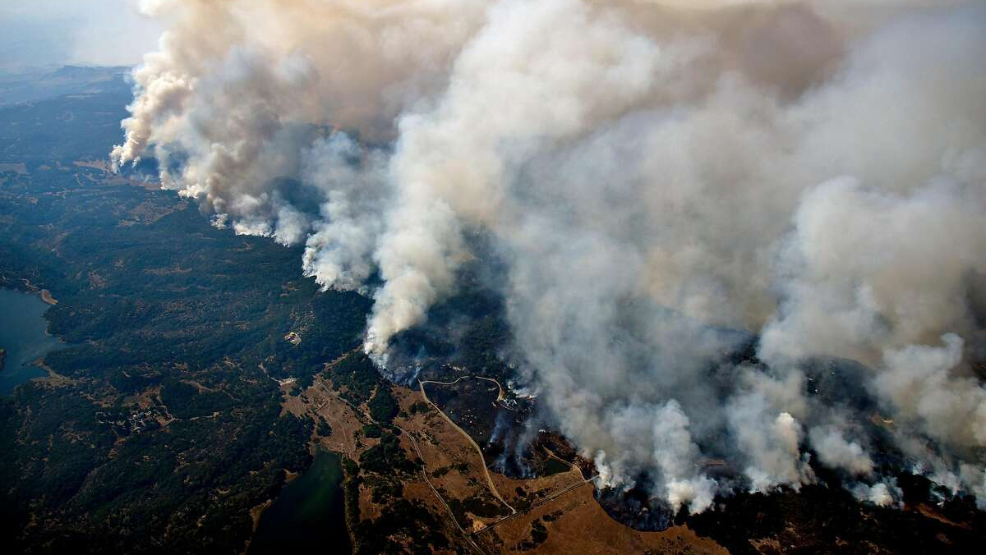

Public Health Sciences
Prenatal Wildfire Smoke Exposure & Child Development Beyond Birth: Associations with Autism and Behavioral Problems in Childhood
Rebecca J. Schmidt, PhD
Professor, Department of
Public Health Sciences
MIND Institute
University of California Davis

Slide 2
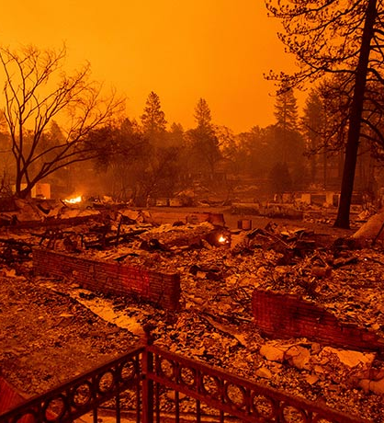
Wildfires are an Increasing Threat to Health
Longer, more severe wildfire seasons, more smoke days^{1,2}
Several of the largest and most destructive fires in last several years with highest fine particulate matter (PM_{2.5}) concentrations ever recorded
Wildfire PM can induce higher toxicity than ambient air PM³
Urban wildfire smoke greater concern because in addition to combustion of organic material, building construction materials and interior furnishings (e.g. solvents, glues, metals, formaldehydes, halogens) may release toxic volatile organic compounds during high temperature combustion
Millions of pregnant people in the US and around the
world breath air contaminated with wildfire PM
MARBLES mothers asked us whether they should be concerned about wildfire smoke exposures in pregnancy
Notes:
1. Westerling AL, Hidalgo HG, Cayan DR, Swetnam TW. Warming and earlier spring increase western U.S. forest wildfire activity. Science. 2006;313(5789):940-943.
2. Diffenbaugh NS, Swain DL, Touma D. Anthropogenic warming has increased drought risk in California. Proc Natl Acad Sci U S A. 2015;112(13):3931-3936.
Wegesser TC, Pinkerton KE, Last JA. California wildfires of 2008: coarse and fine particulate matter toxicity. Environ Health Perspect. 2009;117(6):893-897.

Slide 3

Environmental Exposures during Pregnancy and Early Life
Periconception, gestation, and first years of postnatal life are periods of rapid development and growth
Periods especially vulnerable to environmental exposures
Certain developing organs are particularly sensitive, like brain
Prenatal ambient air pollution linked with birth outcomes (birth weight, preterm birth), respiratory health, and later child neurodevelopmental outcomes, including autism and ADHD
(attention deficit hyperactivity disorder)
Notes:
IPCC Report on health effects of climate change mentioned pregnant people as a vulnerable group for first time in 2022

Slide 4
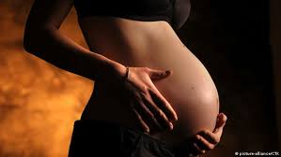
Prenatal Wildfire Exposure and Child Developmental Health
Prenatal wildfire exposure associated with birth outcomes including birth weight, preterm birth, gastroschisis
Questions remain on key exposure timing, those most vulnerable, mechanisms involved
No studies on longer-term child outcomes,
including neurodevelopmental and behavioral outcomes
Notes:
6 studies on WF & birth outcomes

Slide 5
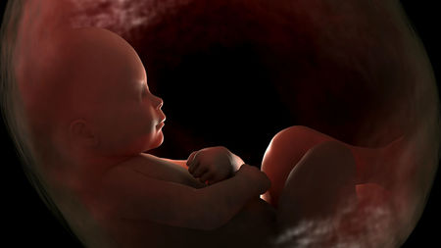
Prenatal Wildfire Exposure & Child Health
Smoke exposure leads to black carbon on fetal side of placenta
Components of smoke (PM, PAH) can trigger inflammatory damage to the placenta blood supply
Potentially impairing placental development & function and
compromising fetal growth
Notes:
The IPCC Report on health effects of climate change mentioned pregnant
people as a vulnerable group for the first time in 2022
PAH = Polycyclic aromatic hydrocarbons
Smoke exposure leads to black carbon
on fetal side of placenta (Bove et al 2019)

Slide 6
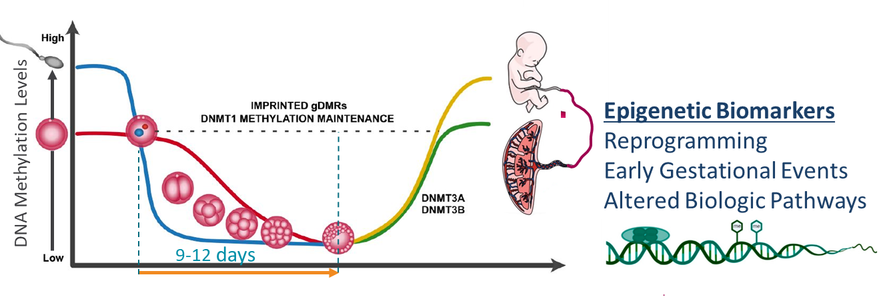
Developmental Origins of Health and Disease (DOHaD)
Environmental exposures during early pregnancy could impact epigenetic reprogramming and have long-term effects

Slide 7

Wildfires & Rhesus Macaques - Closest Animal Model of Human Neurodevelopment and Function
Postnatal 2008 CA exposure associated with immune dysregulation & compromised lung function that persisted into adulthood
(Black et al 2017; Bassein et al 2019)
Early Postnatal 2008 CA wildfire exposure associated with long-term nasal methylome changes over nervous & immune system genes
(Brown et al 2022)
Periconceptional exposure 2018 CA Camp Fire associated with pregnancy loss
(Wilson et al 2021)
Early pregnancy exposure 2018 CA Camp Fire associated with blunted cortisol, passive behavior, memory impairment in infant
(Capitanio et al 2022)
Examining biologic pathways altered using blood collected from infants with CNPRC (Erin Kinnally)
Notes:
Image Source (2024). Wikipedia. “Mother rhesus macaque with her baby.” https://en.wikipedia.org/wiki/Rhesus_macaque
As the closest animal model of human neurodevelopment and function, these macaque studies suggest developmental impacts of wildfires, with an early critical exposure period, immune and neuro-biologic pathways impacted, and behavioral alterations in the offspring.

Slide 8

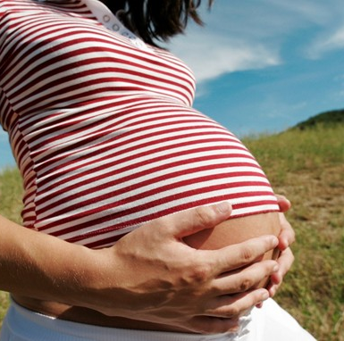
B-SAFE Wildfire Pregnancy Study
Bio-Specimen Assessment of Fire Effects
Cohort of 544 women at different stages of pregnancy during
the 2017-2021 Northern California wildfires and their children
Collected biospecimens and survey information to determine exposure loads, mechanistic responses & health biomarkers
172 enrolled for 2017 Napa/Sonoma wildfires (Tubbs Fire)
225 enrolled for 2018 Camp Fire
18 for 2019 Kincade Fire
95 for 2020 Complex Fires
34 for 2021 Dixie/Caldor Fires

Slide 9
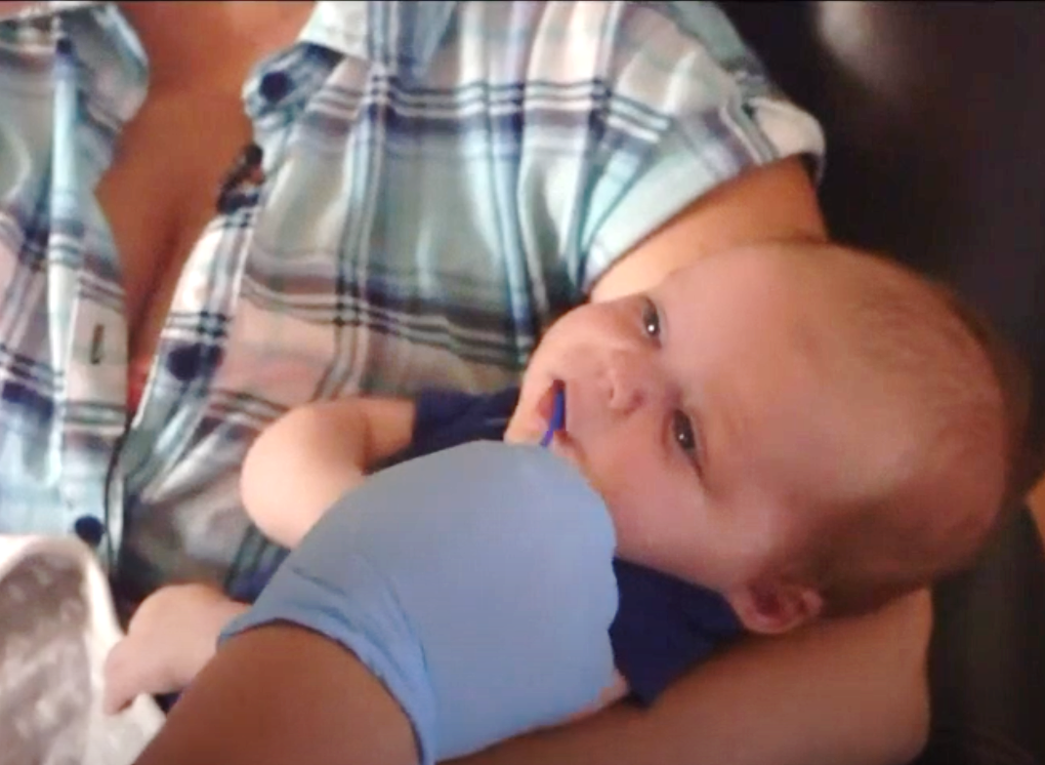
B-SAFE Wildfire Pregnancy Study
Collected information on wildfire experience, stress, demographics, health history, pregnancy, delivery, and postnatal health
Collected Biospecimens:
  Maternal blood, hair, urine, toenails,
  breast milk, MyExposome silicon wristbands
  Placenta & umbilical cord blood at delivery
  Baby’s saliva, toenails, fecal sample,
  dried blood spot, nasal swab
  Older sibling nasal swabs

Slide 10
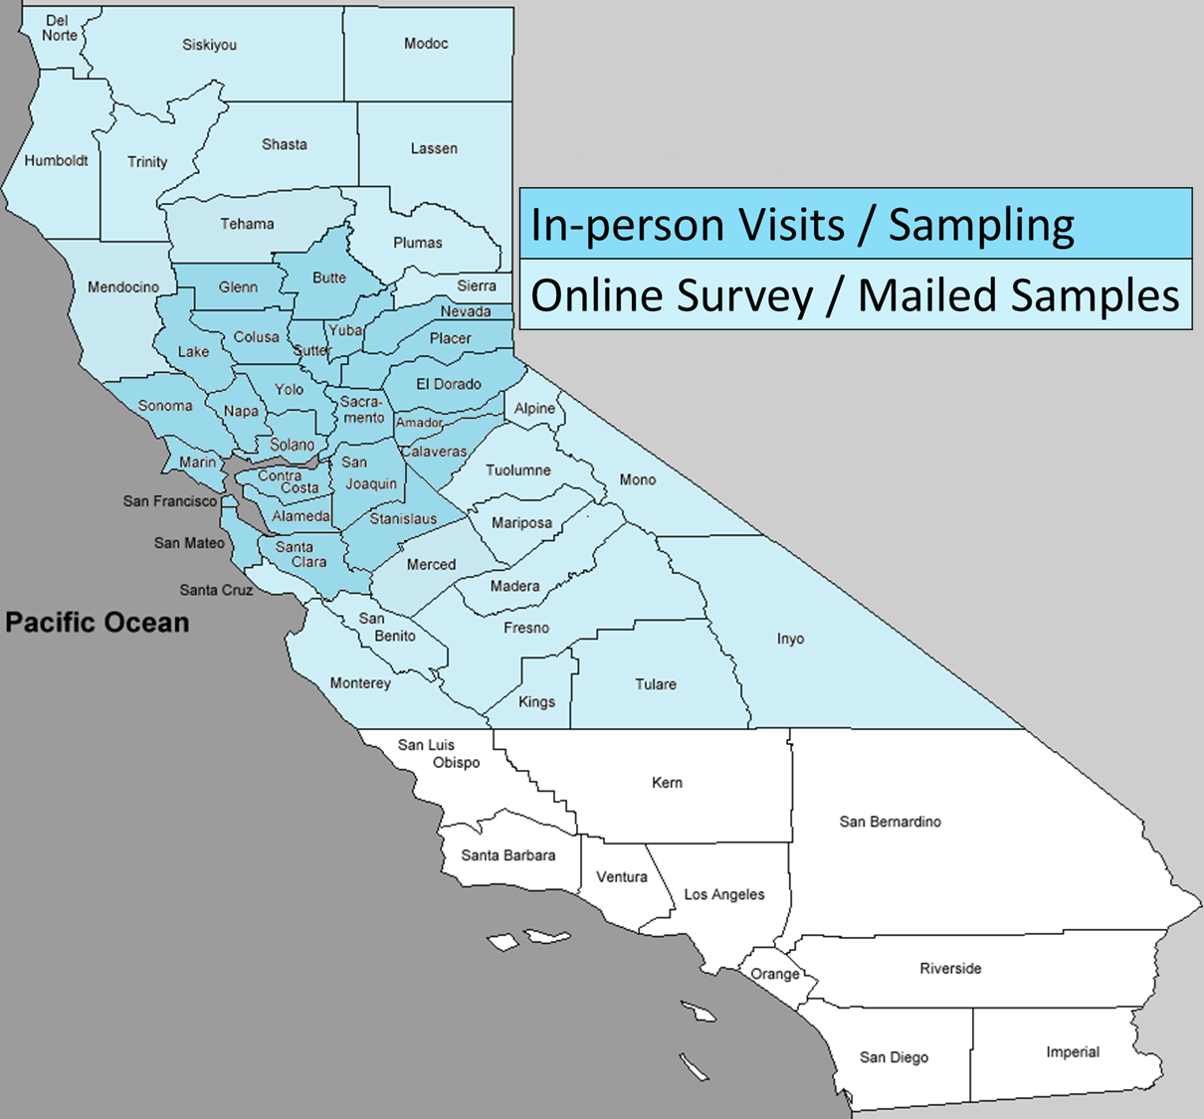
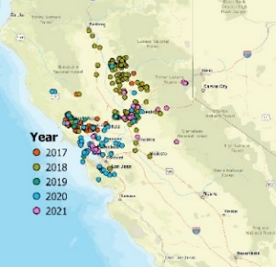
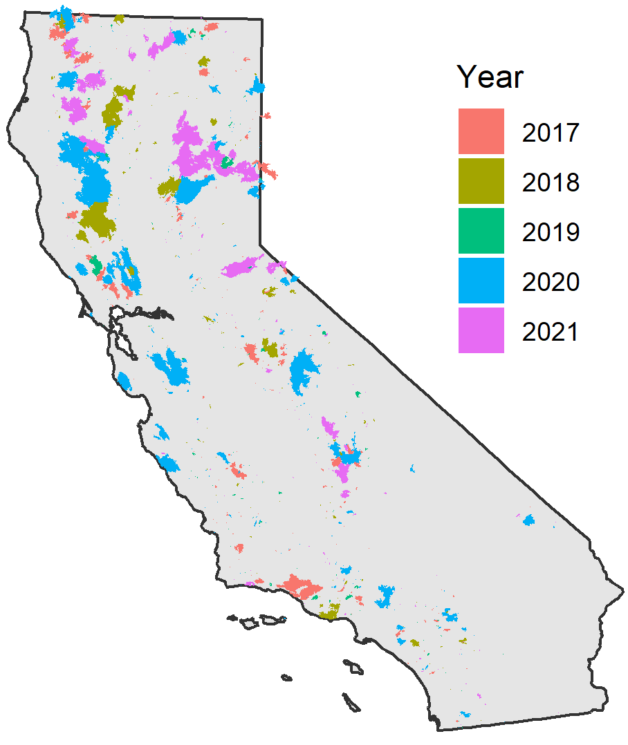
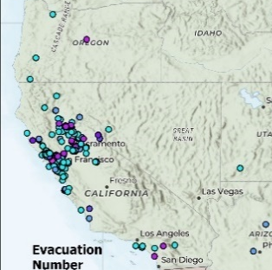
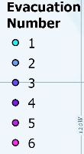
B-SAFE Study Recruitment Area
Map excludes 6 in TX, LA, IL, ML, Canada
Home Locations at Fire Start
Locations of burned areas
Relocations ≤1Yr after Fire
Notes:
≤1Yr Post-Wildfire; Map excludes 6 in TX, LA, IL, ML, Canada

Slide 11
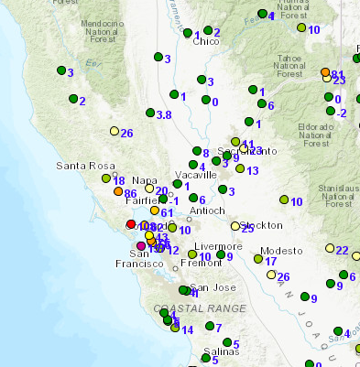
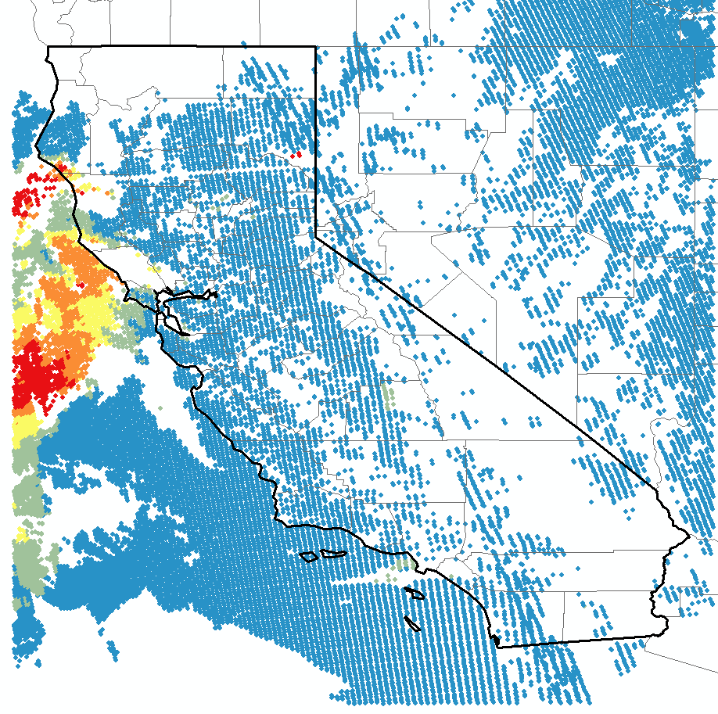
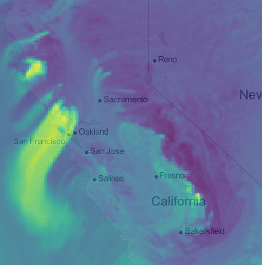
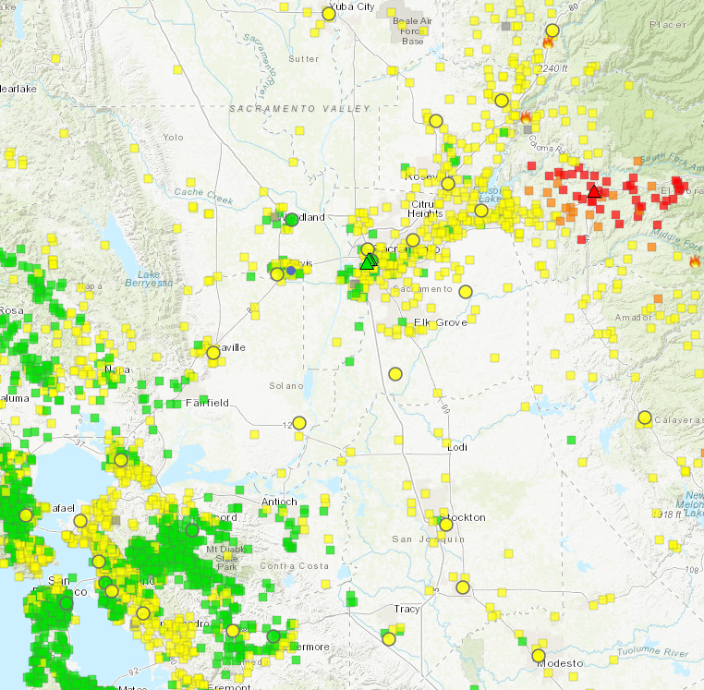
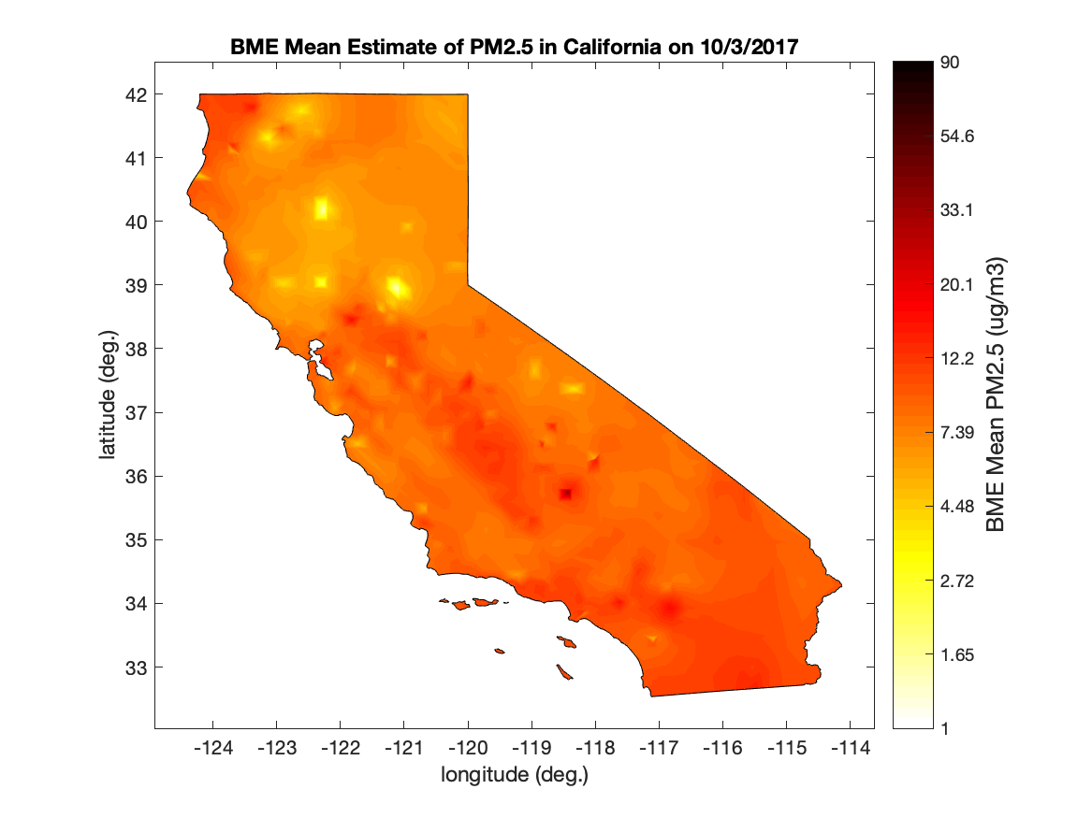
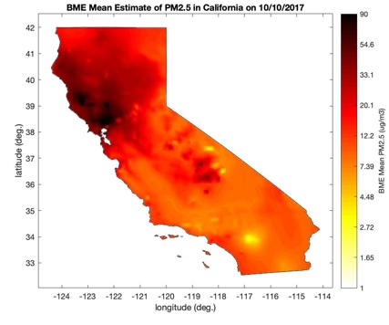

Wildfire-Specific and Background Air Pollution Modeling
Data Fusion Approach
Ground Monitors
Satellite AOD
Air Quality Model
Sensor Network
+
+
+
Mohammad Al-Hamdan
Machine Learning
=
Estimates of daily mean PM_{2.5} during the fire period for exposure assessment
Stephanie Cleland
Rapidfire Methods:
Raffuse S, O’Neill S, Schmidt RJ. A model for rapid wildfire smoke exposure estimates using routinely-available data - rapidfire v0.1.3. EGUsphere 06 Jul 2023. doi.org/10.5194/egusphere-2023-1031.

Slide 12
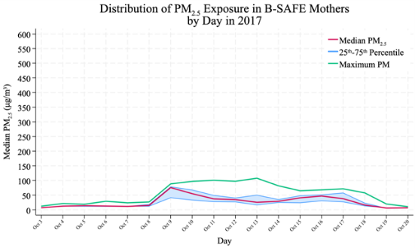
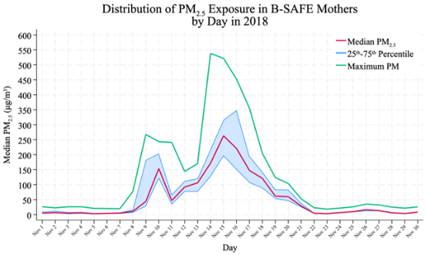
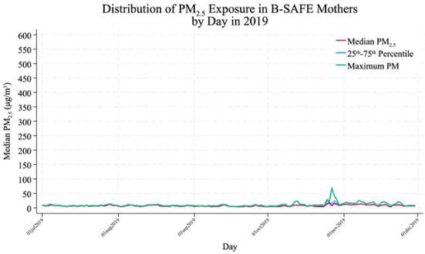
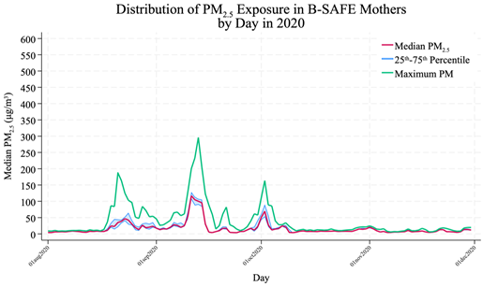
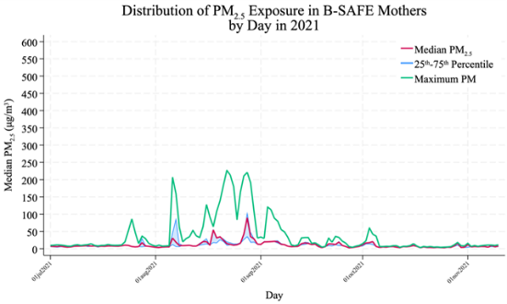
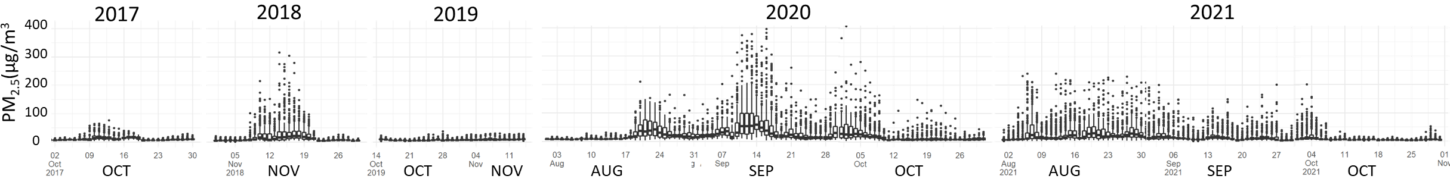
Median Daily PM2.5 Exposure for B-SAFE Mothers during California Wildfire Periods
Sean Raffuse – Data fusion Machine Learning Approach
Oct 2017
Nov 2018
Oct-Nov 2019
Aug-Oct 2020
Aug-Oct 2021

Slide 13

B-SAFE Wildfire Pregnancy Study
Bio-Specimen Assessment of Fire Effects
Findings to Date:
Most commonly reported maternal symptom was
stress/anxiety, persisted up to 1 year
Mothers exposed to higher PM_{2.5} reported:
  More acute respiratory symptoms (cough, sore throat,
  sneezing/cold, wheezing, bronchitis)
  More headaches, nausea, rash
  Greater increases in depressed mood, agitation
Higher 2017 WF PM2.5 not associated with 55 chemicals
measured in maternal serum collected months after the fire
including: flame retardants (PBDEs, PCBs) and PAHs
but oxylipins provided evidence for persistent inflammation
(Park et al, 2025)
Notes:
polybrominated diphenyl ethers (PBDEs) and Polychlorinated biphenyls (PCBs) from household furniture and electronics, and the generation of polyaromatic hydrocarbons (PAHs) from combusted household and structural materials. PBDEs, PCBs and PAHs can adsorb to PM - flame retardants, PCBs, fatty acids and oxylipins on GC triple quad

Slide 14
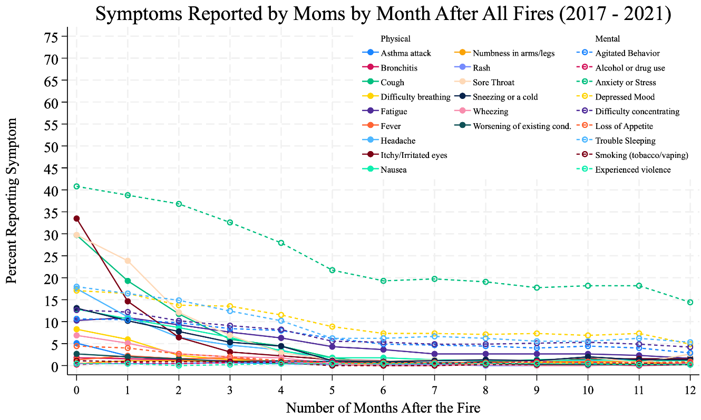
Symptoms Reported by B-SAFE Mothers
~50% reported any symptoms after wildfires
Most commonly reported symptom was Stress/Anxiety, persisted up to 1 yr
Top respiratory symptoms, like itchy/irritated eyes, cough, and sore throat, reported in over a third initially, but dropped steeply after the first month
Trouble sleeping was reported for 10-22% in the first several months
Stress/Anxiety
Itchy/Irritated Eyes
Sore Throat
Cough

Slide 15
More Moms Reported Symptoms with Higher PM_{2.5} Exposure
* Total Respondents N = 440

Slide 16

Pilot Study: Prenatal Wildfire PM_{2.5} and Child CBCL Scores at 4-5 years old
Recruited 125 B-SAFE mothers of children exposed prenatally to 2017 and 2018 wildfires into a follow-up pilot study
(all remote surveys) – Anh Nguyen (respiratory/asthma)
106 completed Child Behavior Checklist (CBCL)
(52 males, 54 females)
Estimates of ground-level 24-hour average PM_{2.5} linked to geocoded residential and evacuation/relocation addresses for B-SAFE families
Linear regression models were used to evaluate association between PM_{2.5} as an average exposure over the course of the wildfire and a child’s CBCL scores
  Analysis by Amanda Goodrich

Slide 17
Significant Associations between Wildfire PM_{2.5} and
Child Behavior on CBCL at Age 4-5 years, in Males
Child Behavior Checklist Outcome | All (N = 106) |  | Males (N = 52) |  | Females (N = 54)
 | RR (95% Cl) | P | RR (95% Cl) | P | RR (95% Cl) | P
Internalizing Problems | 1.53 (1.02, 2.31) | 0.042 | 2.05 (1.44, 2.94) | 0.000 | 0.85 (0.36, 2.01) | 0.707
Externalizing Problems | 1.75 (1.15, 2.68) | 0.010 | 1.90 (1.19, 3.04) | 0.008 | 1.44 (0.64, 3.28) | 0.379
Total Problems | 1.71 (1.22, 2.40) | 0.002 | 1.99 (1.39, 2.86) | 0.000 | 1.40 (0.67, 2.91) | 0.372
Stress Problems | 2.02 (1.19, 3.41) | 0.009 | 2.63 (1.35, 5.14) | 0.005 | 1.23 (0.48, 3.13) | 0.665
Depressive Problems | 1.90 (1.04, 3.47) | 0.036 | 1.96 (0.87, 4.41) | 0.105 | 1.96 (0.65, 5.94) | 0.232
Anxiety Problems | 1.81 (1.22, 2.67) | 0.003 | 2.38 (1.48, 3.83) | 0.000 | 1.64 (0.67, 4.04) | 0.282
ASD Problems | 2.27 (1.13, 4.54) | 0.021 | 4.74 (2.34, 9.58) | 0.000 | 0.49 (0.12, 1.97) | 0.317
ADHD Problems | 1.68 (1.11, 2.54) | 0.014 | 1.37 (0.78, 2.41) | 0.269 | 2.20 (0.97, 4.98) | 0.058
Oppositional Defiant Problems | 1.84 (1.08, 3.14) | 0.024 | 2.16 (1.29, 3.60) | 0.003 | 1.26 (0.40, 4.01) | 0.691
Neg. Binomial Regression Models Adjusted for Maternal Education (< Bachelors Degree Vs Bachelors Degree or Greater), child’s age at time of CBCL, and child’s sex (for ”All” group)
IQR Change in Average PM_{2.5} during wildfire events 2017-2018
Results for Maximum PM_{2.5} during wildfire events were slightly attenuated
Notes:
Here we have Rate Ratios and 95% Confidence Intervals which were obtained from each model. PM2.5 was scaled to an interquartile range, or IQR, change. All models were adjusted for maternal education (< bachelors degree vs bachelors degree or greater) and child’s age, as well as child sex for the unstratified models. Models were also stratified by child sex.
If you aren’t familiar with rate ratios in this context, you can interpret them like any other relative risk, subtract 1 and then it is % increase (or decrease) in scores for a change in PM2.5 from the 25th to 75th percentile
We found that among all children, an IQR (Interquartile Range) change in PM2.5 exposure during the whole pregnancy period was significantly associated with all of the scales we looked at, and that these associations were largely driven by males.
We also looked at Max PM, and those results were slightly attenuated – indicating that the sustained higher smoke exposure, rather than a short high hit increases child behavior problems.

Slide 18
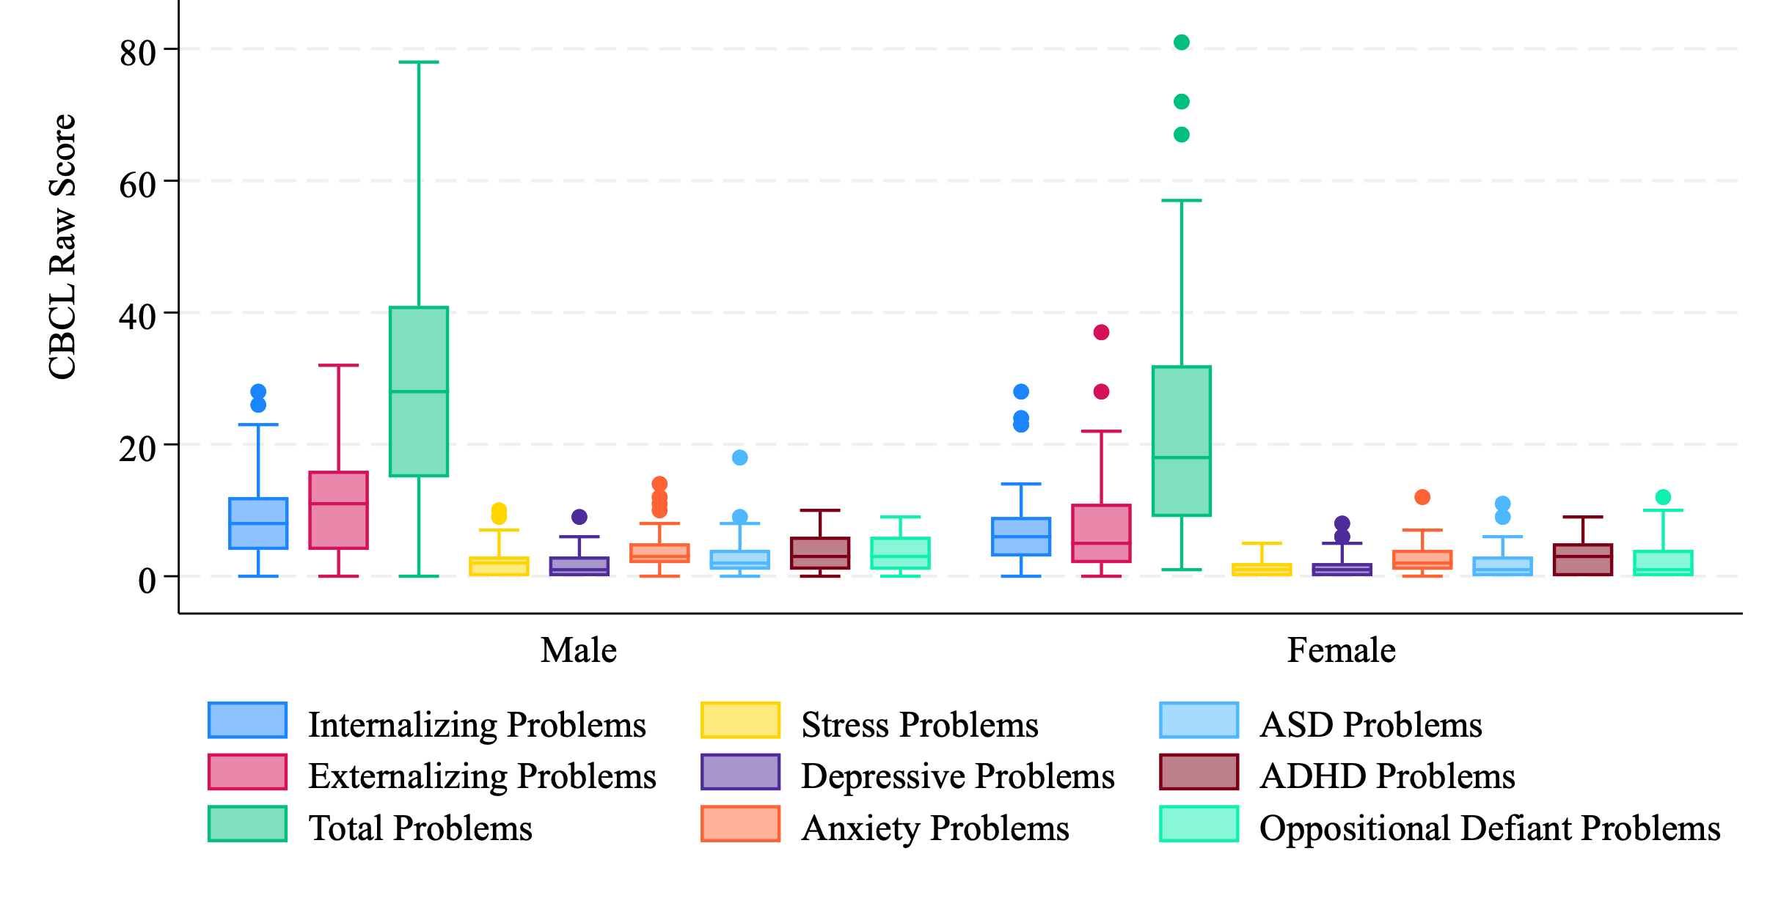
Distributions of CBCL Scores by Child Sex – Age 4-5 yrs
Notes:
Here we have the distributions of the various raw scores by sex. You can see that for the most part, the scores are higher in the males than in the females. This is partly because most of these issues are easier to detect in males at this age.

Slide 19

B-SAFE Follow-Up in Childhood
R01 and CARB funding to assess long-term health of B-SAFE wildfire pregnancy cohort families
Assess neurodevelopmental & behavioral outcomes of WF-exposed children at 7-8 years
  Parent-completed assessments
  Clinical assessment at the MIND Institute
Respiratory health assessment (spirometry)
Assess health of family members by questionnaire
Improved exposure assessment, critical windows
Measuring metals in maternal and baby toenails
Whether maternal stress modulates responses
Examine maternal immune dysregulation – cytokines &
chemokines (in existing blood samples from after fires)
Study epigenetic programming in B-SAFE children;
identify altered pathways
  Saliva as baby and in childhood
  Replicate pathways altered in macaques

Slide 20
Prenatal Wildfire Exposure Associated with Later Child Neurodevelopmental and Behavioral Outcomes
Environmental exposures during early pregnancy could impact epigenetic reprogramming and have long-term effects
Can study epigenetic biomarkers to understand biologic changes associated with both exposures and outcomes
Placenta tissue can reflect gestational events and altered biologic pathways

Slide 21
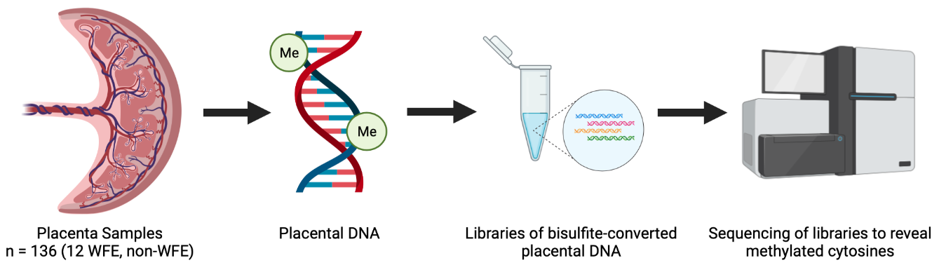
Placenta DNA Methylation in Wildfire-Exposed and Child ASD and Behavioral Outcomes
N=230
WGBS (whole genome bisulfite sequencing) of placental DNA
from MARBLES & B-SAFE Cohorts
Identified comethylation modules and tested for associations with pregnancy wildfire PM_{2.5} exposure and child neurodevelopmental and behavioral outcomes
Genes annotated to modules altered by both wildfire exposure and child neurodevelopmental/behavioral outcomes:
Showed significant enrichment for KEGG pathways relevant to neurodevelopment and cell signaling, including:
  glutamatergic synapse (p = 0.002)
  long-term potentiation (p = 0.002)
  calcium signaling pathway (p = 0.001)
Included three established ASD susceptibility genes (AUTS2, EBF3, and PLCB1) in SFARI Gene database, a significant enrichment (p = 0.018) of SFARI genes
Included recently discovered gene NHIP (neuronal hypoxia inducible, placenta-associated) genetically and epigenetically associated with ASD and hypothesized to protect against neuronal hypoxia and oxidative stress
  Preliminary Analysis by Logan Williams

Slide 22

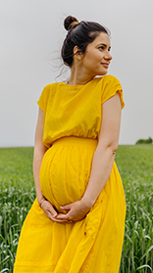

Early Life Vulnerability to Climate-driven Wildfire Events on Pregnancy and Child Developmental Health Outcomes in Underserved Populations
B-SAFE pilot findings indicated that wildfire PM_{2.5} more strongly associated with autism than other developmental outcomes
Needed replication in larger study of more representative population with ability to examine exposure timing
Determine who is most impacted by wildfire smoke in California (2000-2021, 11.2 million births)
Examine how exposure relates to pregnancy outcomes and child neurodevelopmental outcomes
With partners, inform communities on how to protect themselves from smoke exposures
Compounding Factors: Increased vulnerability when combined with other environmental, neighborhood, and contextual factors at individual and community-level: prenatal care, immigration status, SES, demographics, access to greenspace, child opportunity index, background air pollution
Health Outcomes: Birthweight, gestational age/preterm, autism, developmental delay, Cerebral Palsy
Solutions/Impact: Determine whom and when to focus educational campaigns and exposure mitigation tools for the greatest exposure reduction and improvement of child health outcomes; Find ways to improve acceptance of educational training on exposure mitigation among the most vulnerable.
Notes:
Millions of births!
Wildfire-specific and background air pollution will be estimated using both land-use regression and chemical transport models for California in years 2000-2021
This includes ~ 509,000 (400,000-570,000) births per year, for an estimated total of 11,206,082 births.

Slide 23
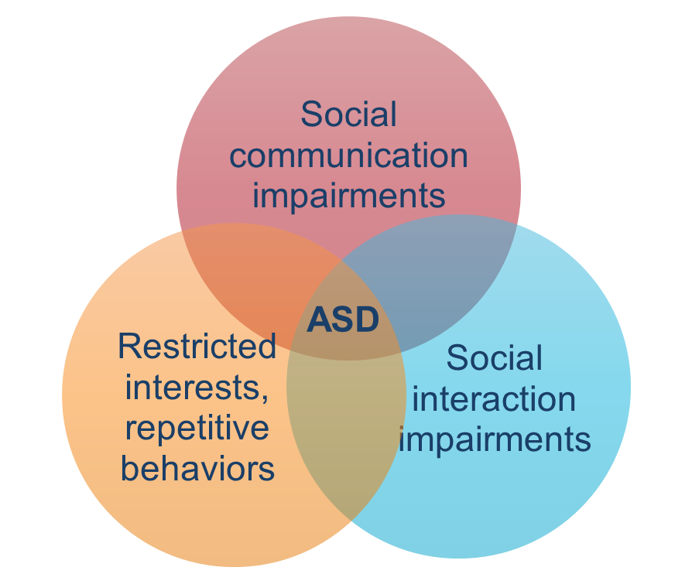
Autism Spectrum Disorder
Complex neurodevelopmental disorder, characterized by:
Persistent deficits in social communication and social interaction
Restricted and repetitive patterns of behavior, interest, or activities
Neurobiological basis – aberrant brain development
Symptoms are usually present by age 3 years
Diagnostic process is complex
(American Psychiatric Association)
Notes:
4 yr 2 mo in US ADAAM; 5 yr globally

Slide 24
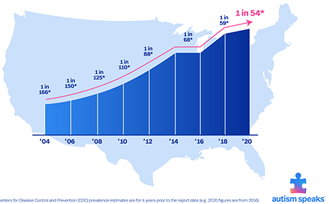


Autism Prevalence
CDC’s Autism and Developmental Disabilities Monitoring (ADDM) Network active surveillance of ASD
Prevalence in US: 1 in 31 children
by age 8 (32.2 per 1000)
Affects 3.4 Boys for every 1 Girl
(skewed sex ratio)
49.2 and 14.3 in 1000
  1 in 20 boys; 1 in 70 girls
Prevalence increasing over time
536% Increase since 2000
1 in 31
1 in 36
1 in 44
1 in 54
2021
2023
5% in boys
1.4% in girls
(Shaw et al., 2025)
Notes:
https://www.cdc.gov/mmwr/volumes/74/ss/ss7402a1.htm#:~:text=Results:%20Among%20children%20aged%208,neighborhood%20MHI%20at%20five%20sites.
Autism and Developmental Disabilities Monitoring (ADDM) Network active surveillance of ASD
To ascertain ASD among children aged 8 years, ADDM Network staff review and abstract developmental evaluations and records from community, medical and educational service providers.
Minority groups tend to be diagnosed later and less often
39.6% of children with ASD have an intellectual disability (intelligence quotient [IQ] <70)

Slide 25
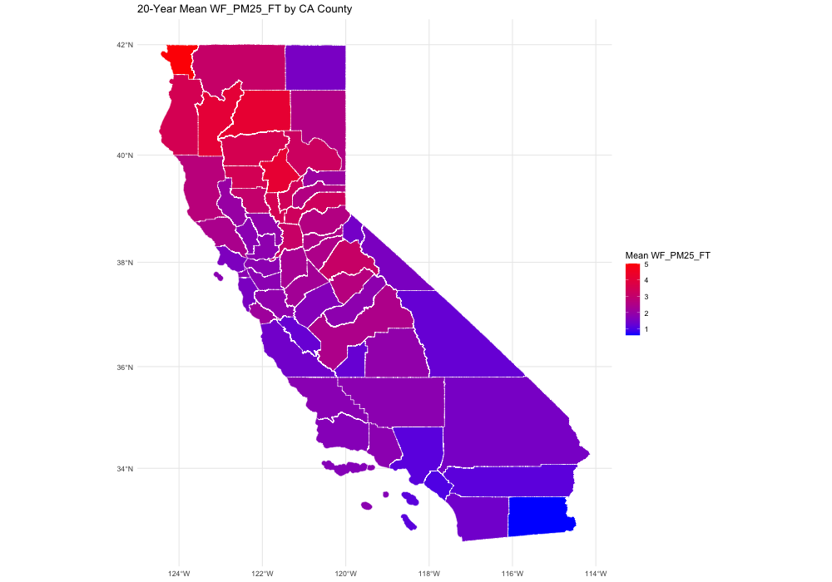
Wildfire Exposure
Daily exposure to WF smoke PM_{2.5} predicted with chemical transport model adjusted for measured PM_{2.5} concentrations using Random Forest Regression
Wildfire-related PM_{2.5} exposure, including tracers for biomass burning & wildland urban interface (WUI) estimated for preconception, prenatal, & postnatal periods
Wildfire PM_{2.5} exposure linked to geocoded birth addresses for 9,860,442 births in California 2000-2020
Mean daily wildfire PM_{2.5} exposure for pregnancy mapped by county for all pregnant mothers over past 20 years – Northern CA Counties most impacted
Model questions: Mike Kleeman
mjkleeman@ucdavis.edu
  Map by Amanda Goodrich

Slide 26
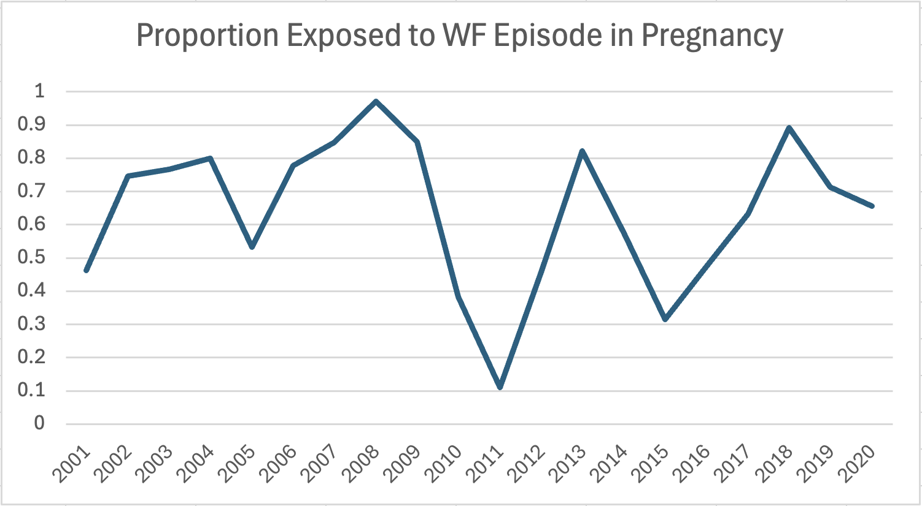
Most Pregnancies are Exposed to a Wildfire Episode
Across all years (2001-2020),
6,325,790 64% were exposed (of 9,860,442 births)
to at least one wildfire episode over 9 ug/m³ in pregnancy
Varied by year,
highest in 2008 (97%),
lowest in 2011 (11%)
On Average 316,290 pregnancies exposed per year in California
Notes:
Proportion exposed to at least one wildfire episode over 9 ug/m3 during pregnancy
The EPA regulation is for 9 ug/m3, but in some cases, the models have shown adverse health effects below this level
National annual health-based air quality standard for fine particulate matter (PM2.5) to 9 micrograms per cubic meter (µg/m³)

Slide 27
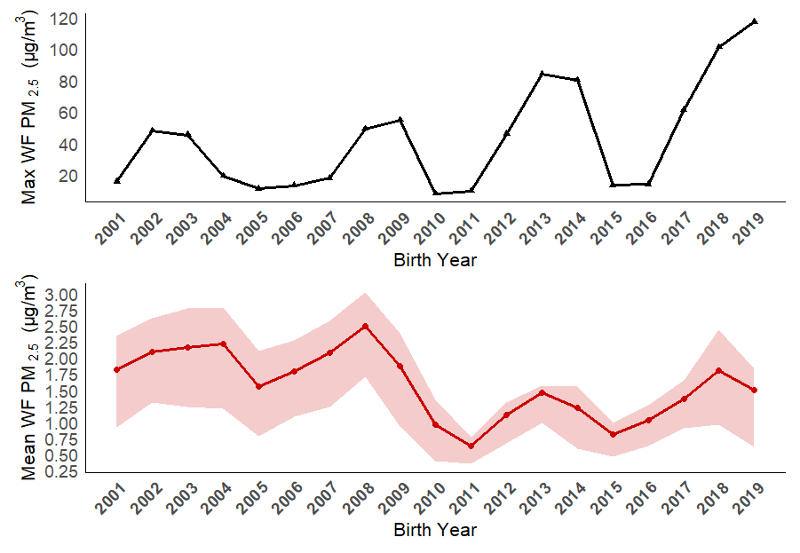
Mean Pregnancy Wildfire/Combustion PM_{2.5} Over Time
Wildfire PM_{2.5} exposure is episodic
Peak wildfire PM_{2.5} levels vary sharply from year to year
Early years include biomass burning (wood combustion) from stoves
High-intensity fires causing large peaks appear more common in recent years
Notes:
Combustion wood burning – includes wood stoves

Slide 28
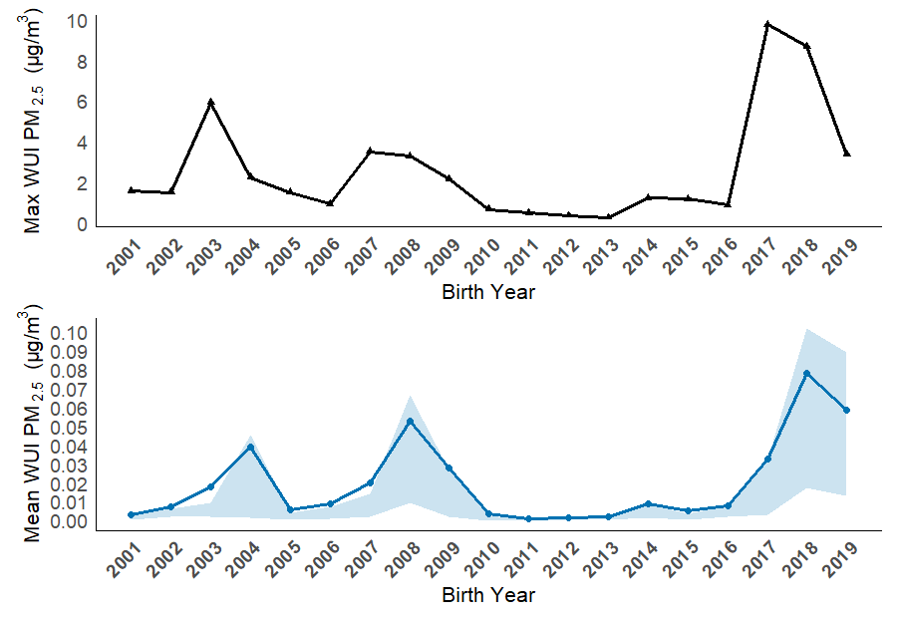
Mean Pregnancy Wildfire WUI PM_{2.5} Over Time
WUI PM_{2.5} exposure is episodic
Maximum WF WUI PM_{2.5} pregnancy values are noticeably higher than the means
A noticeable period of high peaks in more recent years

Slide 29
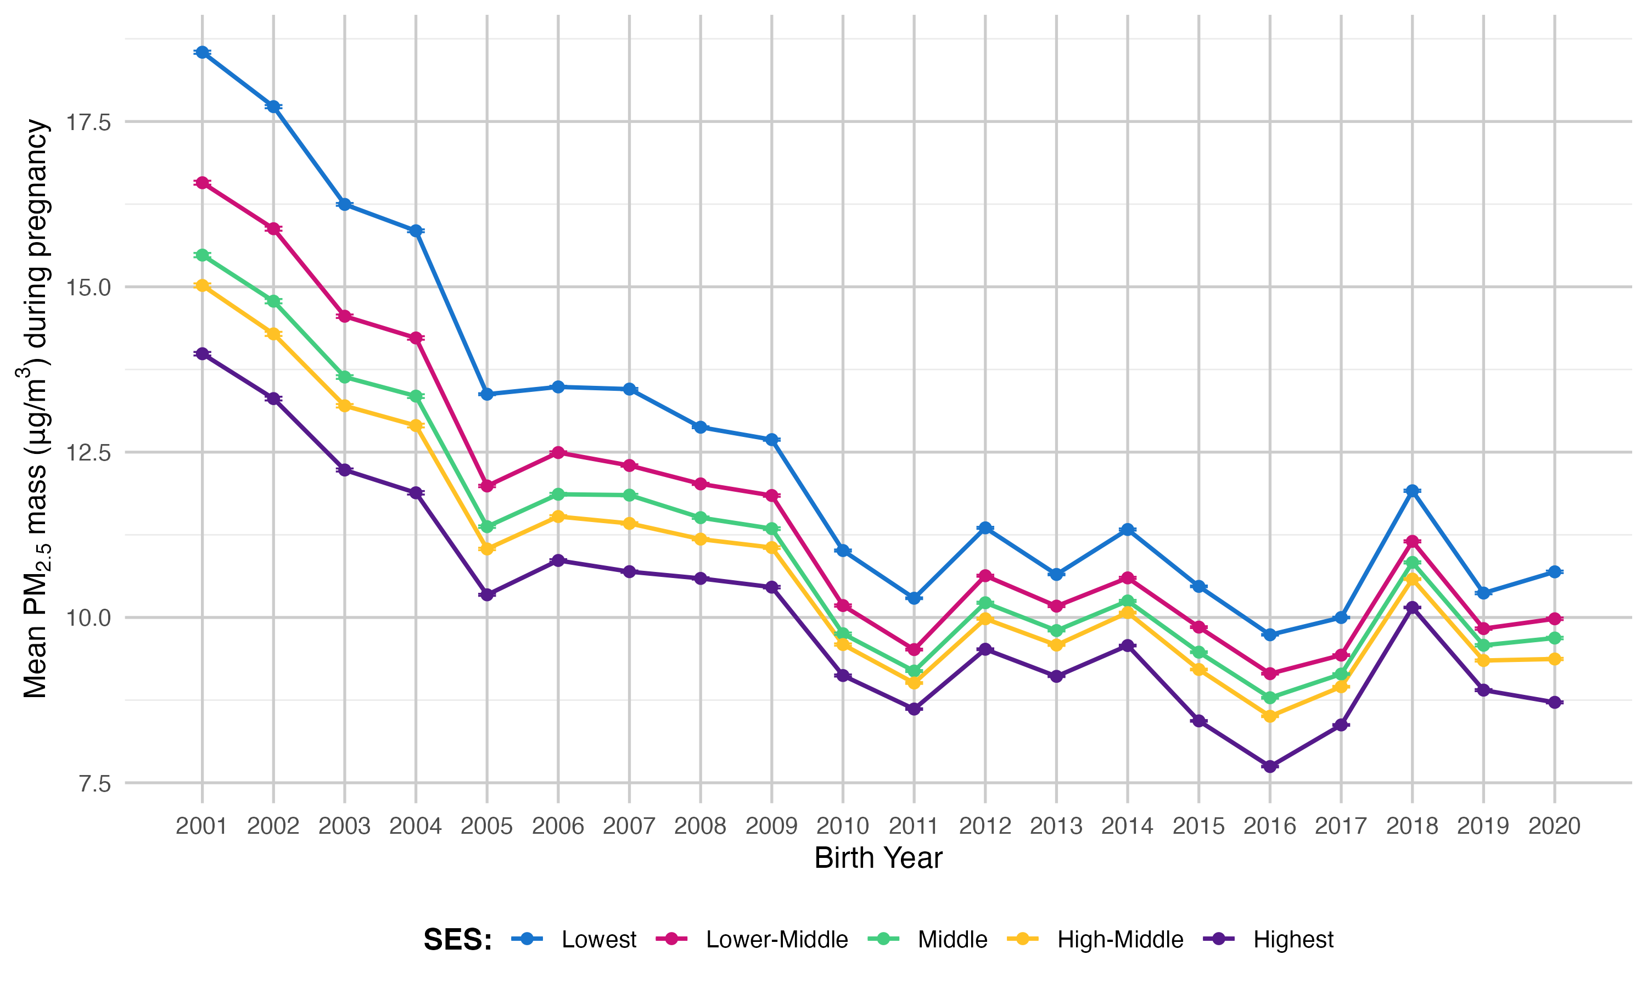
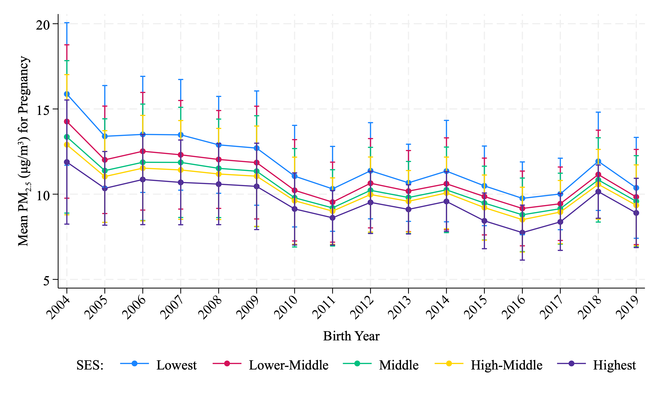
Mean Total PM_{2.5} During Pregnancy across Year and by SES
  Plot by Amanda Goodrich
Total N Births: 9,860,442

Slide 30
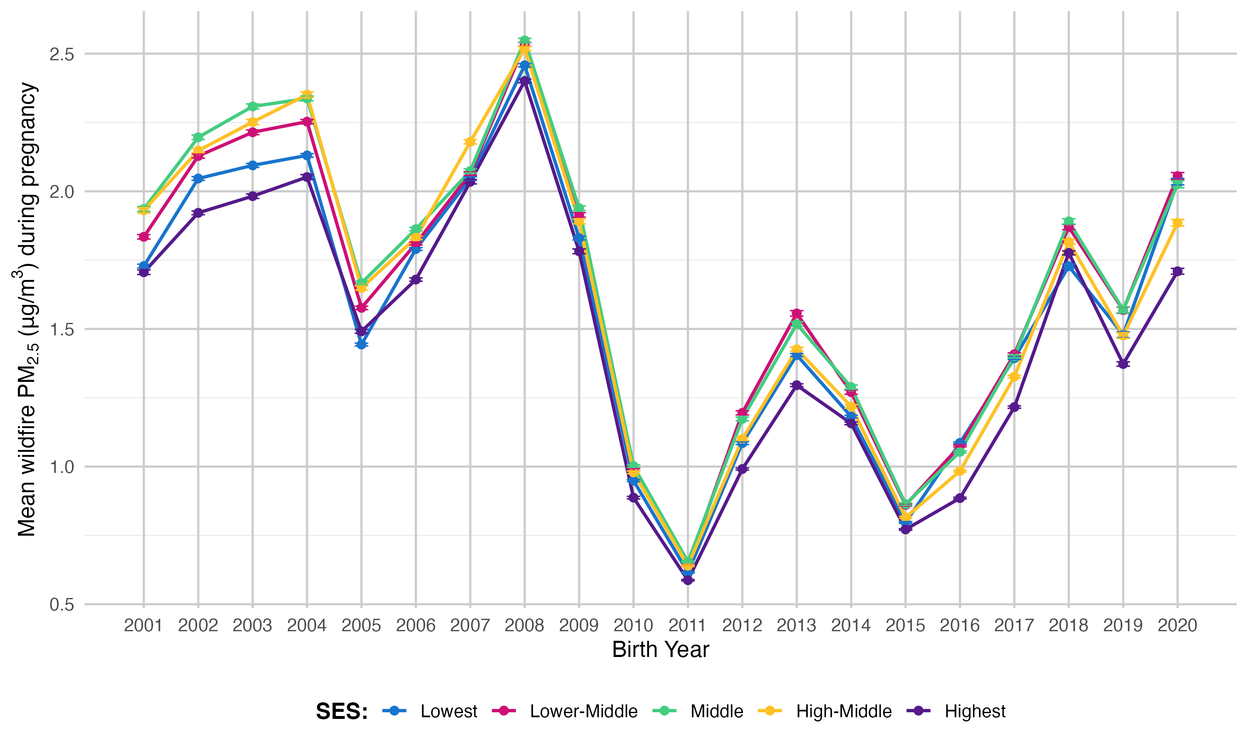
Mean Wildfire PM_{2.5} During Pregnancy
across Year and by SES
  Plot by Amanda Goodrich
Total N Births: 9,860,442

Slide 31
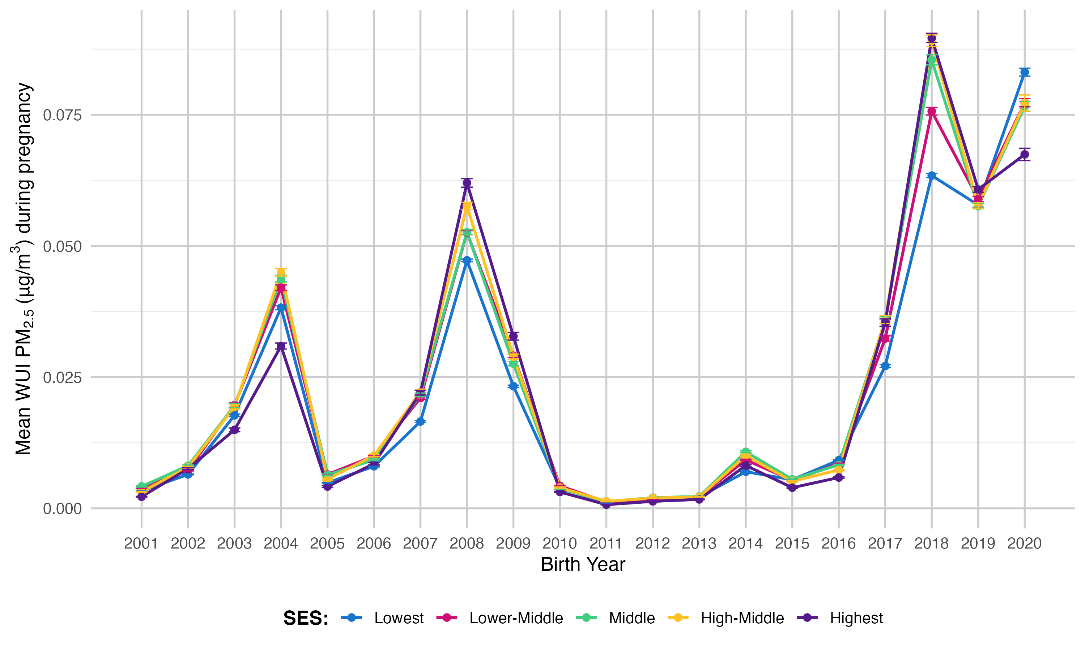
Mean WUI (Wildland Urban Interface) Wildfire PM_{2.5} During Pregnancy across Year and by SES
  Plot by Amanda Goodrich
Total N Births: 9,860,442
Notes:
WUI Wildfires more prevalent in recent years

Slide 32
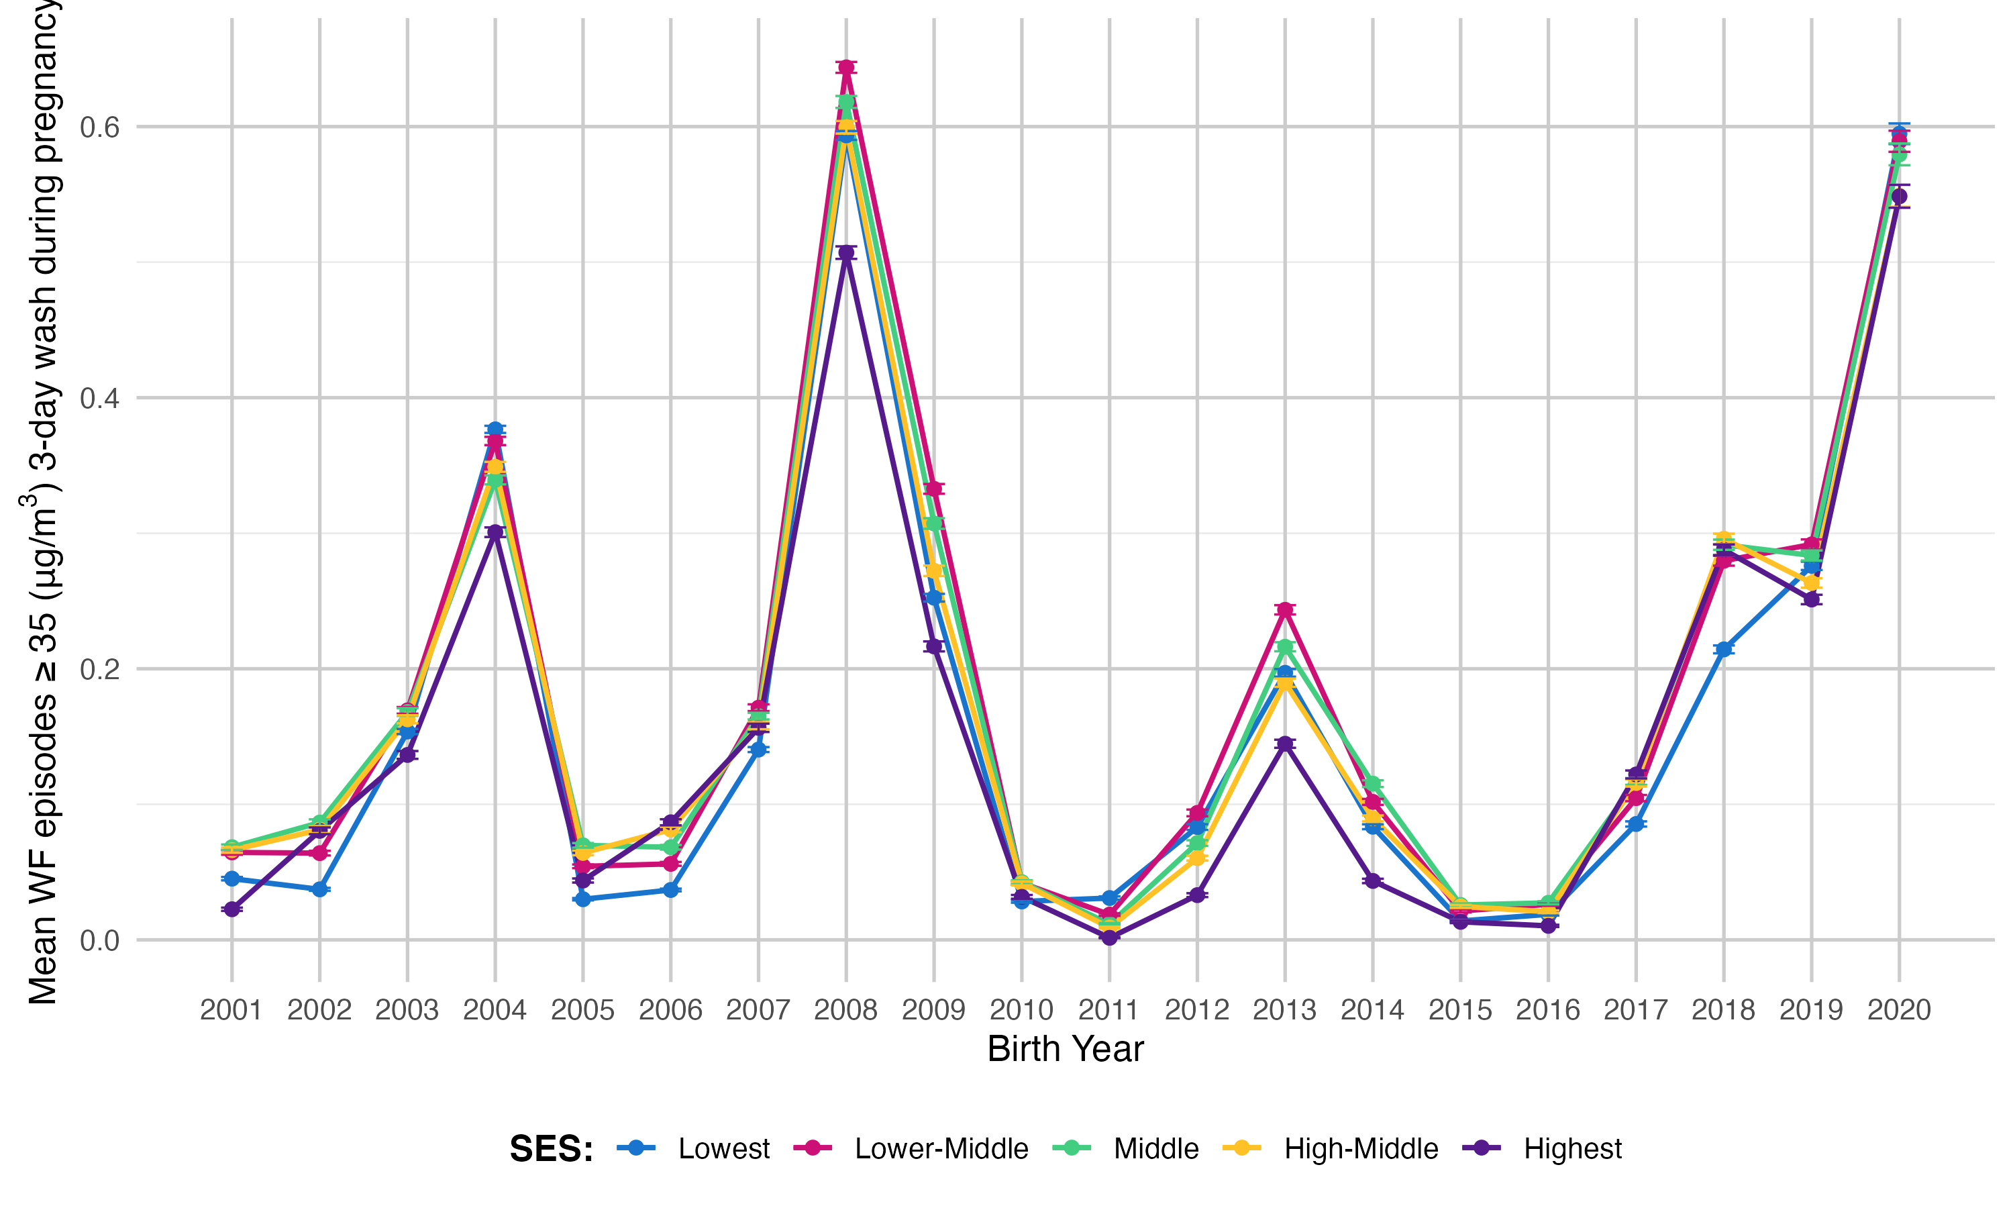
Mean Wildfire Episodes ≥35 µg/m³ (3-Day Wash) During Pregnancy across Year and by SES
  Plot by Amanda Goodrich
Total N Births: 9,860,442
Notes:
And WF with higher concentrations more prevalent in recent years
24-hour standard for fine particulate matter (PM2.5) set by the U.S. Environmental Protection Agency (EPA). Specifically, it's the level of 35 micrograms per cubic meter that the EPA has established as the maximum allowable concentration of PM2.5 in the air over a 24-hour period to protect public health. This standard is part of the National Ambient Air Quality Standards (NAAQS) for particulate matter.
Here's a more detailed explanation:
PM2.5:
Refers to particulate matter with a diameter of 2.5 micrometers or less. These tiny particles can penetrate deep into the lungs and cause various health problems.
24-hour standard:
This standard is designed to protect against short-term exposure to high concentrations of PM2.5, particularly in areas with significant pollution sources or during events like wildfires.
35 µg/m³:
This is the concentration limit set by the EPA. If the average PM2.5 concentration over a 24-hour period exceeds this level, the air quality is considered unhealthy.
NAAQS:
The EPA sets and periodically reviews NAAQS for various pollutants, including PM2.5, to protect public health and welfare.
Health Impacts:
Exposure to PM2.5 can lead to various health issues, including respiratory problems, cardiovascular problems, and premature death.
Environmental Justice:
The EPA recognizes that certain communities, particularly those with environmental justice concerns, may be disproportionately impacted by PM2.5 pollution.
The National Ambient Air Quality Standards for Particle Pollution
THE AIR QUALITY INDEX (AQI) On Dec. 14, 2012 the U.S. Environmental Protection Agency (EPA) strengthened the nation's air quality ...
U.S. Environmental Protection Agency (.gov)
Standards - Fact Sheet - Environmental Protection Agency (EPA)
Jan 6, 2023 — standard at the level of 35 µg/m3. ... PM2. 5 is a pollutant of great concern to already overburdened and vulnerable co...
U.S. Environmental Protection Agency (.gov)
2006 National Ambient Air Quality Standards (NAAQS) for ...
Dec 18, 2006 — Rule Summary In 2006, based on the EPA's review of the air quality criteria and national ambient air quality standards...
U.S. Environmental Protection Agency (.gov)

Slide 33
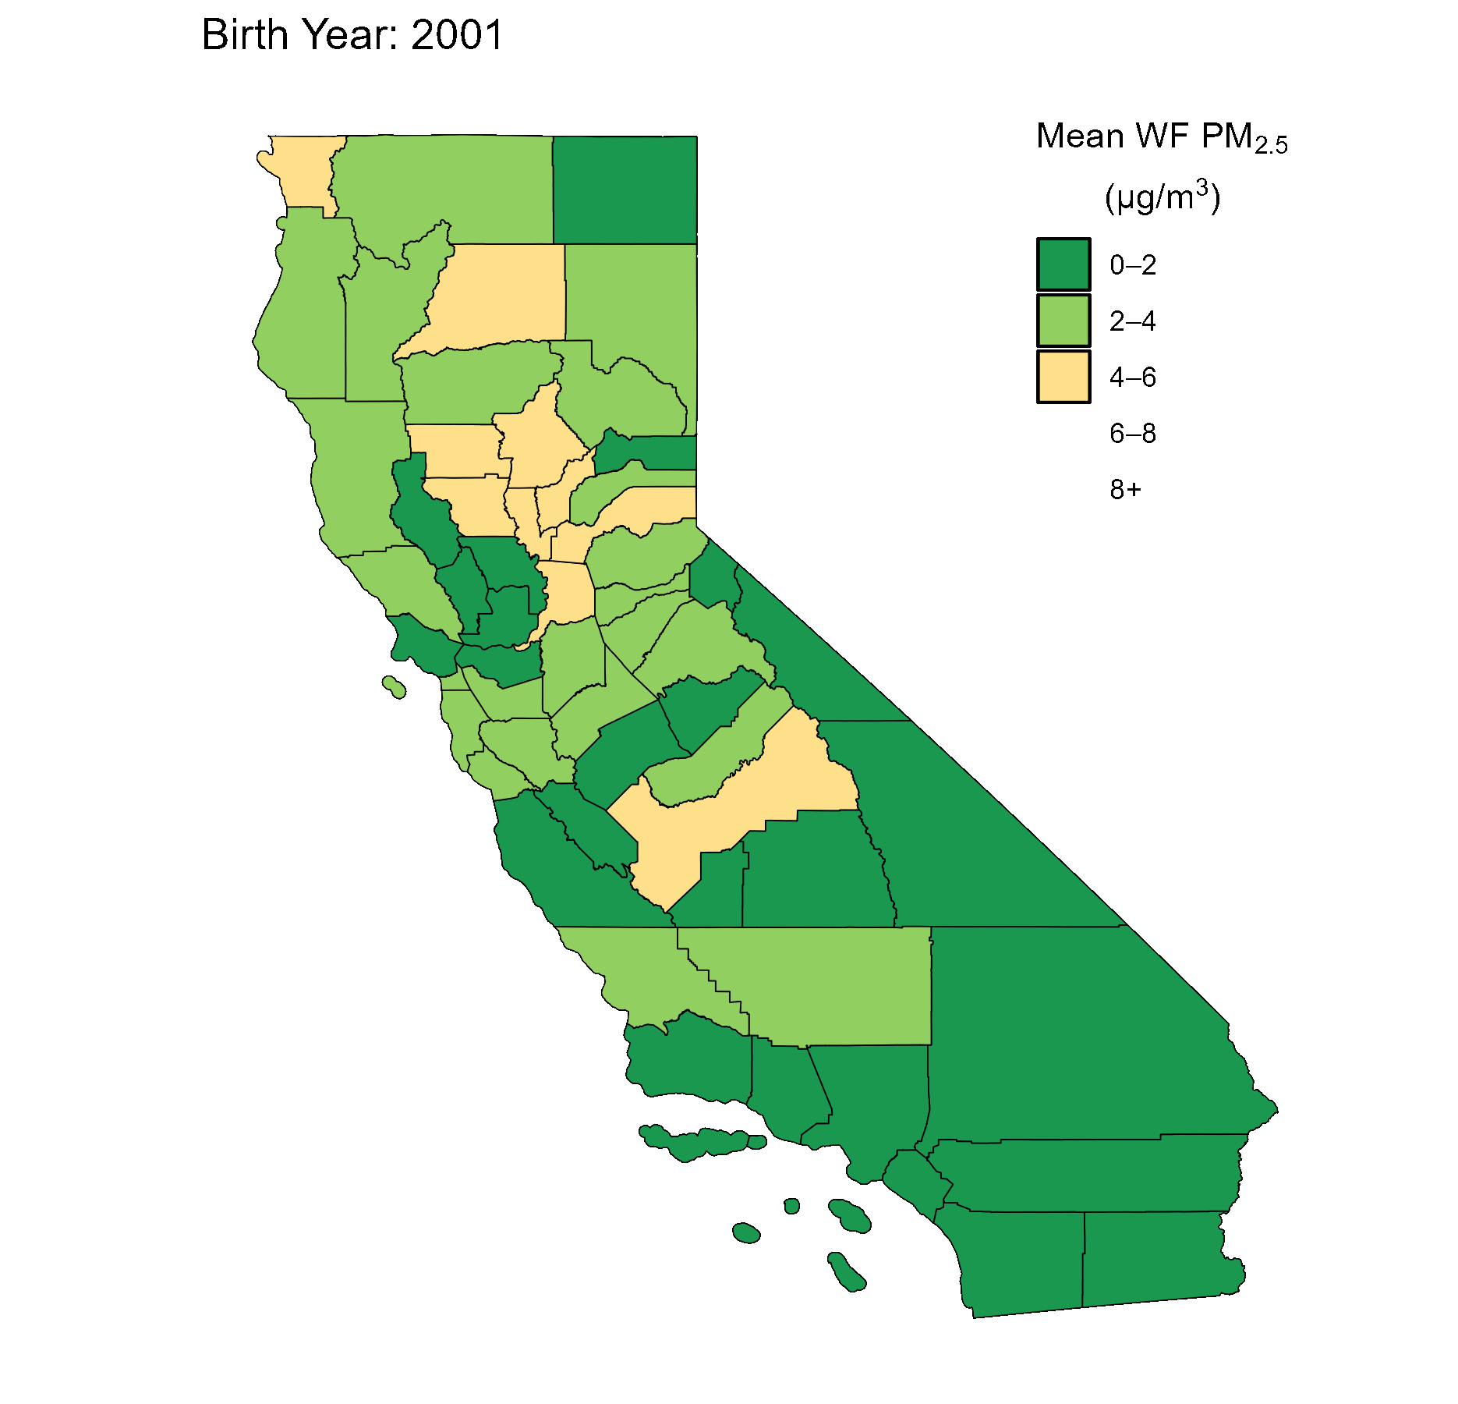
Approach
Daily PM_{2.5} from wildfire smoke exposure was estimated using a chemical transport model, calibrated with observed PM_{2.5} levels through Random Forest Regression
Pregnancy wildfire-associated PM_{2.5} exposure, encompassing tracers for biomass burning and
wildland-urban interface (WUI) burning
Exposure measures included continuous (IQR-scaled), percentile-based (30th, 60th, 90th), and episode-based indicators defined by thresholds of ≥ 9 and ≥ 35 µg/m³
2001-2019 California birth records linked to ASD cases reported by the CA Dept of Developmental Services through end of 2022 (N=8,628,369 births; ASD=118,339)
DDS captures ~75–80% of all ASD cases in California
Logistic regression to estimate odds ratios (ORs) adjusted for sociodemographic and perinatal factors
Model questions: Mike Kleeman
mjkleeman@ucdavis.edu
  Analysis by Karl O’Sharkey (UCLA)

Slide 34
Mean Total PM_{2.5} During Pregnancy across Year and by SES
  Plot by Amanda Goodrich
Total N Births: 9,860,442

Slide 35
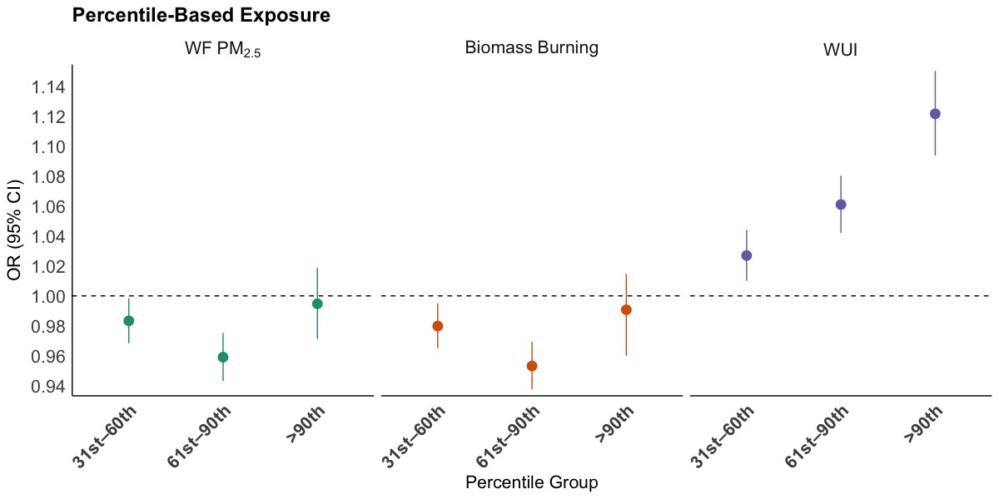
Higher-Intensity WF Episodes Linked to Increased ASD Risk
No associations for WF PM_{2.5} or Biomass Burning using percentile-metrics
  WUI (11% increased risk 90th vs 0-30th (reference group)
  Analysis by Karl O’Sharkey (UCLA)
Notes:
WUI Wildfires more prevalent in recent years

Slide 36
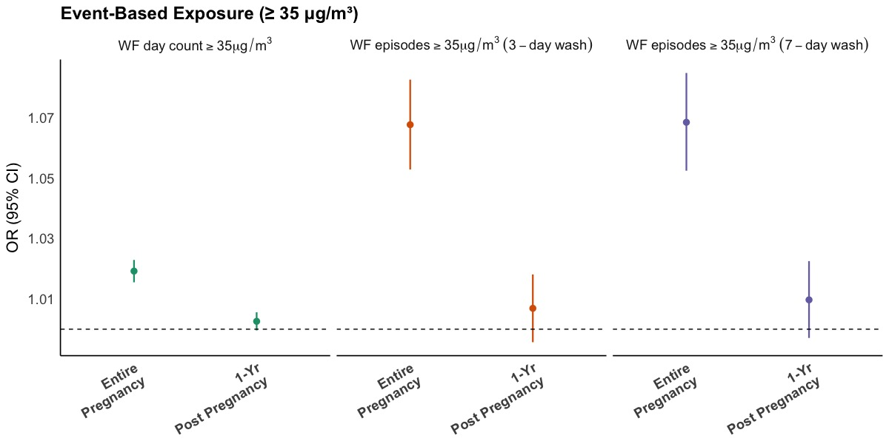
Higher-Intensity WF Episodes Linked to Increased ASD Risk
WUI likely reflects localized, high-intensity smoke in populated areas
Intense WF PM_{2.5} episodes (≥ 35 µg/m³) during pregnancy increased risk (7%)
  Analysis by Karl O’Sharkey (UCLA)
Notes:
WUI Wildfires more prevalent in recent years

Slide 37
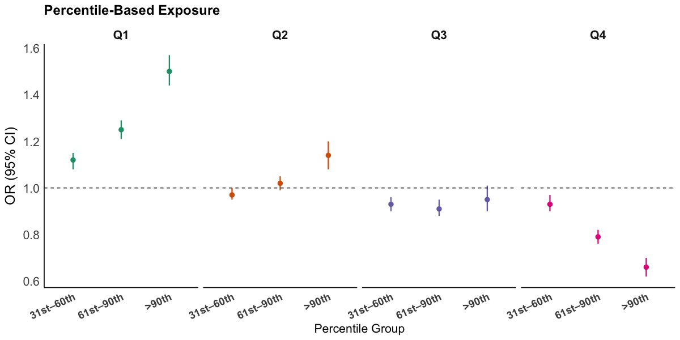
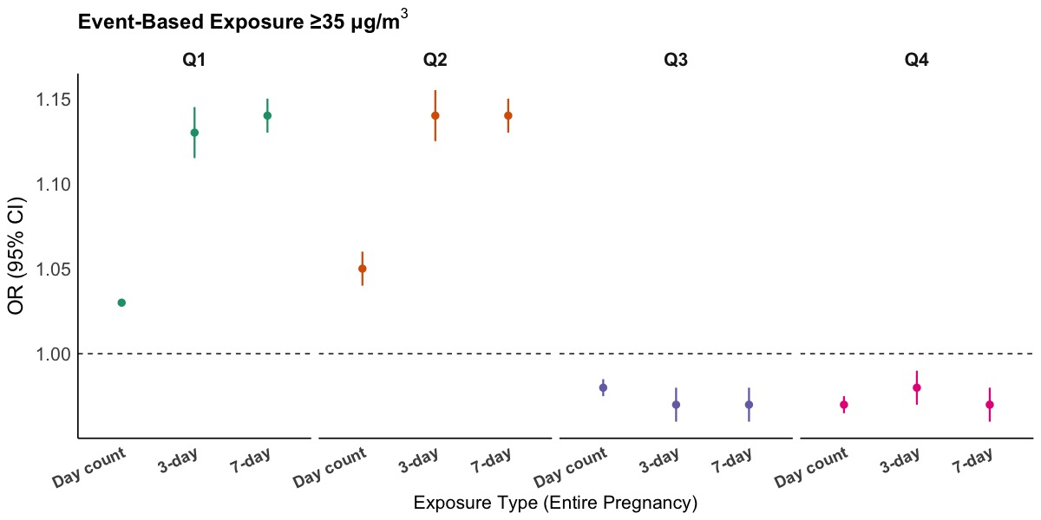
Strongest WF Effect in Lower Background PM2.5 Settings
Percentile-Based Exposures
Event-Based Exposures ≥ 35 µg/m³
Quartile of Background Air Pollution
Quartile of Background Air Pollution
Strongest associations observed in lowest background PM_{2.5} quartile (Q1)
Event-based metrics show higher risk in Q1–Q2, but little to no effect in Q3–Q4
  Analysis by Karl O’Sharkey (UCLA)
Notes:
WUI Wildfires more prevalent in recent years

Slide 38

Summary of Findings from State-wide Linkage Study
Higher WF PM_{2.5} exposure concentrations and repeated high exposure episodes (≥35 µg/m³) were associated with increased risk of ASD
A one-IQR (1.18 µg/m3) increase in WF PM_{2.5} exposure during pregnancy associated with 4% increased ASD risk (95% CI: 1.03, 1.05), adjusting for non-WF PM_{2.5} and key maternal and demographic covariates
Pregnancies top 10% exposure had 17% increased ASD risk (95% CI: 1.14,1.21)
while those in 90th–50th percentile had modest 3% increased risk (95% CI: 1.01, 1.04), compared to those below the median exposure
Number of distinct high-exposure episodes increased risk, each additional episode of WF PM_{2.5} ≥35 µg/m³ after 3-day unexposed washout period increased risk by 10% (95% CI: 1.08, 1.12) and after a 7-day washout period by 12% (95% CI:1.09, 1.14)
Lower-intensity WF exposure events (≥9 µg/m³) showed no associations – threshold
Associations most pronounced among children in lowest quartile of background PM_{2.5} with pregnancy >90th percentile wildfire PM_{2.5} increasing the odds of ASD by 50%
Sex differences were minimal, but stronger associations for WUI-related PM_{2.5} and high exposure episodes for males
  By Karl O’Sharkey (UCLA)

Slide 39

Conclusions
Wildfire smoke exposure during pregnancy may increase risk for autism and other behavioral outcomes, especially in areas with lower background air pollution, and potentially for males
However, in higher pollution settings, wildfire smoke may contribute to pregnancy loss, introducing live birth bias that could be attenuating observed associations
Associations were strongest for high-intensity, episodic wildfire exposures – low-concentration exposures were not associated with increased risk
Findings highlight the potential for long-lasting neurodevelopmental disturbances associated with extreme and recurrent wildfire smoke exposure in pregnancy
More research will be done to identify critical exposure windows and to understand key exposure components and mechanisms to inform public health risk mitigation strategies

Slide 40
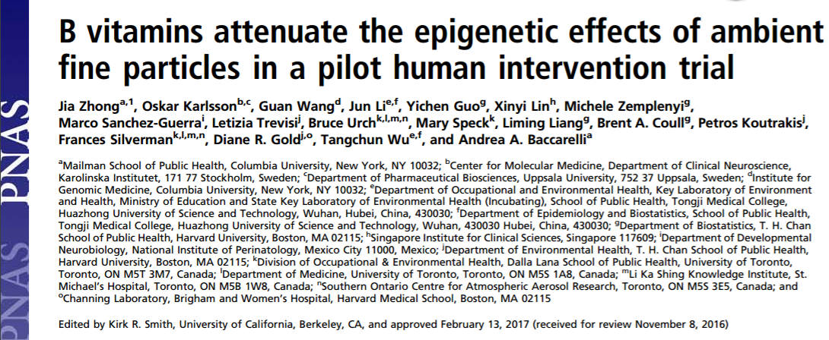
Evidence for Protective Effects by B-Vitamins / Folic Acid
ABSTRACT Acute exposure to fine particle (PM_{2.5}) induces DNA methylation changes implicated in inflammation and oxidative stress. We conducted a crossover trial to determine whether B-vitamin supplementation averts such changes. Ten healthy adults blindly received a 2-h, controlled-exposure experiment to sham under placebo, PM_{2.5} (250 μg/m³) under placebo, and PM_{2.5} (250 μg/m³) under B-vitamin supplementation (2.5 mg/d folic acid, 50 mg/d vitamin B₆, and 1 mg/d vitamin B₁₂), respectively. We profiled epigenome-wide methylation before and after each experiment using the Infinium HumanMethylation450 BeadChip in peripheral CD4⁺ T-helper cells. PM_{2.5} induced methylation changes in genes involved in mitochondrial oxidative energy metabolism. B-vitamin supplementation prevented these changes. Likewise, PM_{2.5} depleted 11.1% [95% confidence interval (CI), 0.4%, 21.7%; P = 0.04] of mitochondrial DNA content compared with sham, and B-vitamin supplementation attenuated the PM_{2.5} effect by 102% (P_{interaction}=0.01). Our study indicates that individual-level prevention may be used to complement regulations and control potential mechanistic pathways underlying the adverse PM_{2.5} effects, with possible significant public health benefit in areas with frequent PM_{2.5} peaks.
PM_{2.5} induced methylation changes in genes involved in mitochondrial oxidative energy metabolism. Supplementation with vitamin B6, B12 and folic acid prevented these changes. Likewise, PM_{2.5} depleted mitochondrial DNA content by 11.1% [95% CI: 0.4%, 21.7%; P = 0.04] compared with sham, and B-vitamin supplementation attenuated the PM_{2.5} effect by 102% (P_{interaction} = 0.01)
Zhong et al, 2017
Notes:
PM2.5 induced methylation changes in genes involved in mitochondrial
oxidative energy metabolism. B-vitamin supplementation prevented
these changes. Likewise, PM2.5 depleted 11.1% [95% confidence interval
(CI), 0.4%, 21.7%; P = 0.04] of mitochondrial DNA content
compared with sham, and B-vitamin supplementation attenuated
the PM2.5 effect by 102% (Pinteraction = 0.01)

Slide 41
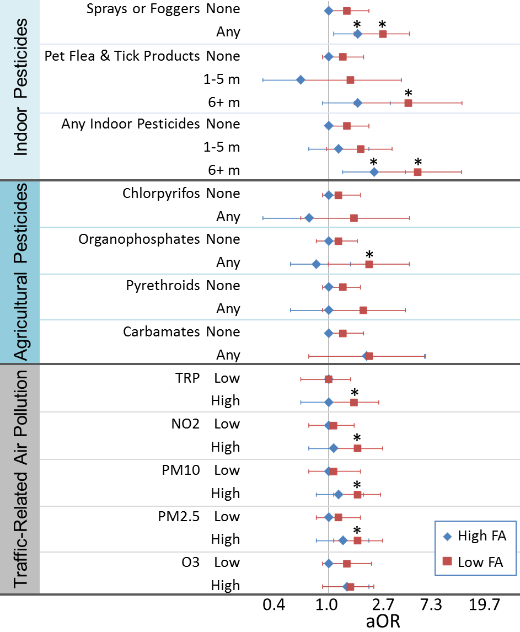
Supplemental Folic Acid x Environmental Contaminant Interactions
Autism ORs for pesticides and air pollution higher when mothers had low periconceptional folic acid
(Schmidt et al. 2017; Goodrich et al. 2018)
Effect modification of autism associations between phthalates and periconceptional folic acid supplements in MARBLES
(Shin et al. 2018)
Effect modification of autism trait associations between phthalates and prenatal folic acid in MIREC
(Oulhote et al. 2020)
Folic acid might attenuate associations between prenatal contaminants & autism in the child
PESTICIDES
AIR POLLUTION
Higher Autism Risk

Slide 42
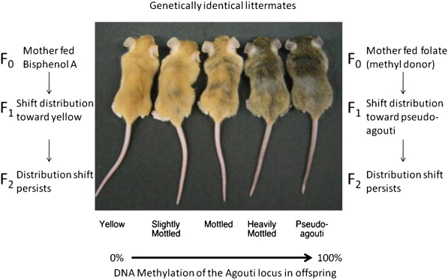
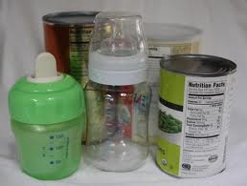

Folic Acid Can Counter Contaminant Effects
In both human and animal experimental studies:
    Environmental contaminants → DNA methylation changes
    Supplemental folic acid reversed the DNA methylation changes
In mice, this also countered the health effects in offspring
Notes:
PM2.5 induced methylation changes in genes involved in mitochondrial
oxidative energy metabolism. B-vitamin supplementation prevented
these changes. Likewise, PM2.5 depleted 11.1% [95% confidence interval
(CI), 0.4%, 21.7%; P = 0.04] of mitochondrial DNA content
compared with sham, and B-vitamin supplementation attenuated
the PM2.5 effect by 102% (Pinteraction = 0.01)

Slide 43

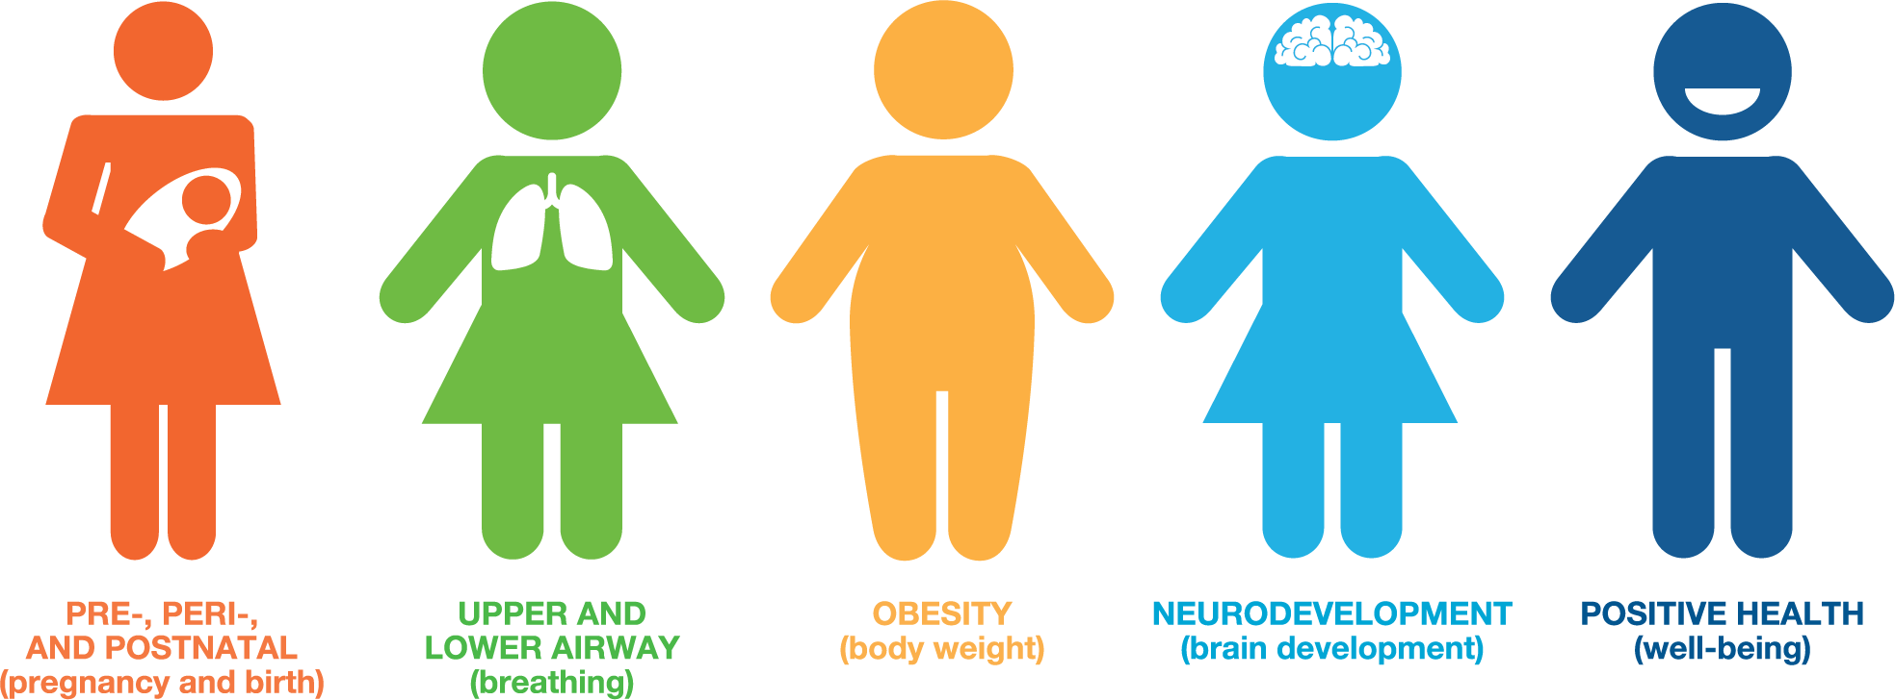

Prenatal Environment And Child Health (PEACH) in ECHO (Environmental influences on Child Health Outcomes)
ECHO: Largest U.S. Cohort of 50,000 Children – supported by NIH
Mission: Enhance the health of children for generations to come
PEACH ECHO recruiting 700+ new pregnancies in Sacramento region
NIH UG3 OD035550 9/1/2023 – 8/31/2030
PEACH Team Research:
  Prenatal Wildfire PM exposure and Neurodevelopmental Outcomes
  Address unresolved disparities in periconceptional folate status and associations with downstream child health
  Exposures to novel plasticizing chemicals, wildfires, and other environmental factors
  Interactions between these prenatal exposures
  Intermediary epigenetic and biologic pathways
Notes:
Observational and Intervention Studies
The proposed work will address innovative research questions regarding unresolved disparities in
periconceptional folate status and associations with downstream child health, exposures to novel plasticizing
chemicals and other environmental exposures in relation to later child neurodevelopmental outcomes,
interactions between these prenatal exposures, and potential intermediary epigenetic and biologic pathways.
This work will help us to understand how factors could be modified to improve health outcomes of children, as
well as identify the sub-populations of expecting families that might benefit most from preventive measures that
can move us towards reducing the burden of neurodevelopmental disorders and improve the quality of life for
children, with direct implications for clinical guidelines and public health recommendations.

Slide 44
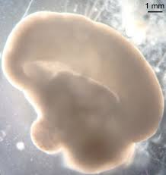
Future Directions
Mechanistic Studies using Biospecimens
Experimental Models – Brain Organoids
Exposure Measurements
Collaborations with LA Fire Researchers
Expand B-SAFE in Future Fires
Intervention Studies
Community Education
Notes:
Maternal and cord blood

Slide 45



  Collaborating Investigators - UCD
  Mike Kleeman – Exposure Assessment, Modeling
  Deborah Bennett – Exposure Measurement
  Katie Conlon – Exposure Assessment; Geo Indexes
  Sean Raffuse – Exposure Assessment, Modeling
  Miriam Nuno – Biostatistician; Community Engagement
  Amanda Goodrich – Research Analyst
  Mohammad Astaneh – Exposure Modeling
  Yusheng Zhao – Exposure Modeling
  Daniel Tancredi – Biostatistician
  Hong Ji – Nasal Respiratory Epigenetics / Cytokines
  Ameer Taha – Blood Exposure Measurements
  Lisa Miller – Primates Respiratory Immune Profiles
  Anh P Nguyen – Pediatric Allergist and Immunologist
  Irva Hertz-Picciotto – Environmental Epidemiologist
  Tanya Khemet – Community Engagement/Outreach
  Erin Kinnally – NHP Behavior, Epigenetics, CNPRC
  Logan Williams – GRA, WGBS Bioinformatics
  Findings Presented
  Amanda Goodrich – B-SAFE, EPA
  Karl O’Sharkey – EPA Autism
  Logan Williams – WF WGBS
  Karl O’Sharkey – WF Assignment, Analysis
  Beate Ritz – Exposure, Birth Record, DDS Data
  Sanjali Mitra – Data Mgt
  Ting Chow – Data Mgt
  Research Team
  McKenzie Oliver – Study Manager
  Maria Mora – Phlebotomist, Field, Lab
  Elizabeth Angel – Data Manager/Analyst
  Luis Perucho Jaimes – Laboratory
  Timothy Sullivan – Laboratory Manager
  Funding
  NIH NIEHS R01ES037032, R21ES029852, R21ES031026, UG3/UH3 OD035550, R01ES028089, R01ES025574, R01ES029213, R/U24ES028533, P01ES011269, P50HD103526
  EPA STAR 83543201, 84048401 UCD EHS Center pilot; MIND Institute IDDRC; CNPRC
Notes:
Compare blood contaminants to: proximity to fire, symptoms, and ash
Compare survey items to cortisol

Slide 46

Thank You!
rjschmidt@ucdavis.edu

