Slide 1
Pilot Prospective Study of Biomarkers and Symptoms of Latent Labor
Katherine Kissler, PhD, CNM University of Colorado Anschutz College of Nursing
Elise Erickson, PhD, CNM University of Arizona School of Nursing
Julia C. Phillippi, PhD, CNM Vanderbilt University School of Nursing
Ellen Tilden, PhD, CNM Oregon Health Science University College of Nursing

Slide 2
Research Questions
Feasibility
Prospective Real-Time Symptom/Experience Data Collection
Uterine Electromyography during term pregnancy and labor
Longitudinal Blood Sampling during term pregnancy and labor
Biobehavioral measurement prior to hospital admission
Prospective
Longitudinal
Self-Report
Wearable Devices

Slide 3
Sample
18 Nulliparous participants with low-risk pregnancies
Enrolled at 37 Weeks Gestation

Slide 4
Planned Data Collection
Uterine EMG continuously from 37 weeks through active labor
37 Weeks EGA: Enrollment
Demographics/AcE Score
Initial blood draw
Weekly Blood Draws
Symptom report whenever participant identified significant symptoms q3hrs until symptom resolution
Survey immediately postpartum and at 6 weeks postpartum

Slide 5
Collected Data
Data Type | Quality
Symptom Reports | 13 with at least one symptom report | Total of 191 symptom reports (avg of 10/participant)
Qualitative Survey Responses: Voice-to-text or Written | 5 participants (6 responses in real time) | 15 participants responded retrospectively
Blood Samples | 15 with at least two blood samples
Uterine EMG | 14 with at least 30 minutes of interpretable data

Slide 6

Real-Time Prospective Self-Report

Slide 7
Real Time Qualitative Survey Responses
Option for Voice-to-Text

Slide 8
IL-6 May Increase Prior to Spontaneous Labor More than Induced Labor

Slide 9
IL-8 may not differ

Slide 10
IL-10 may not differ

Slide 11
TNF-α may not differ

Slide 12
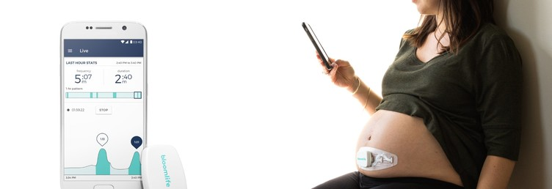
Uterine EMG Monitoring
Bloom Life LLC Promotional Material

Slide 13
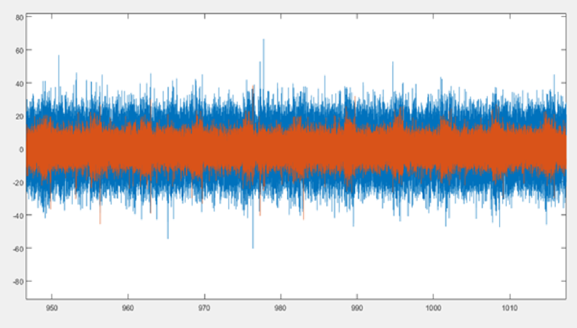
Sample EMG Data “Normal” Labor
Filtered and Zoomed Out
Time (mins)
Notes:
Over 1 hour

Slide 14
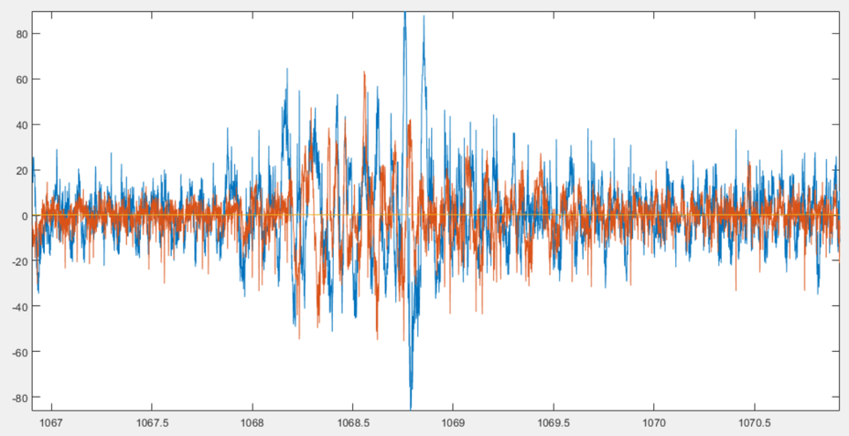
Sample EMG Data “Normal” Labor
Filtered and Zoomed In
Time (mins)
Notes:
Over 3 mins

Slide 15
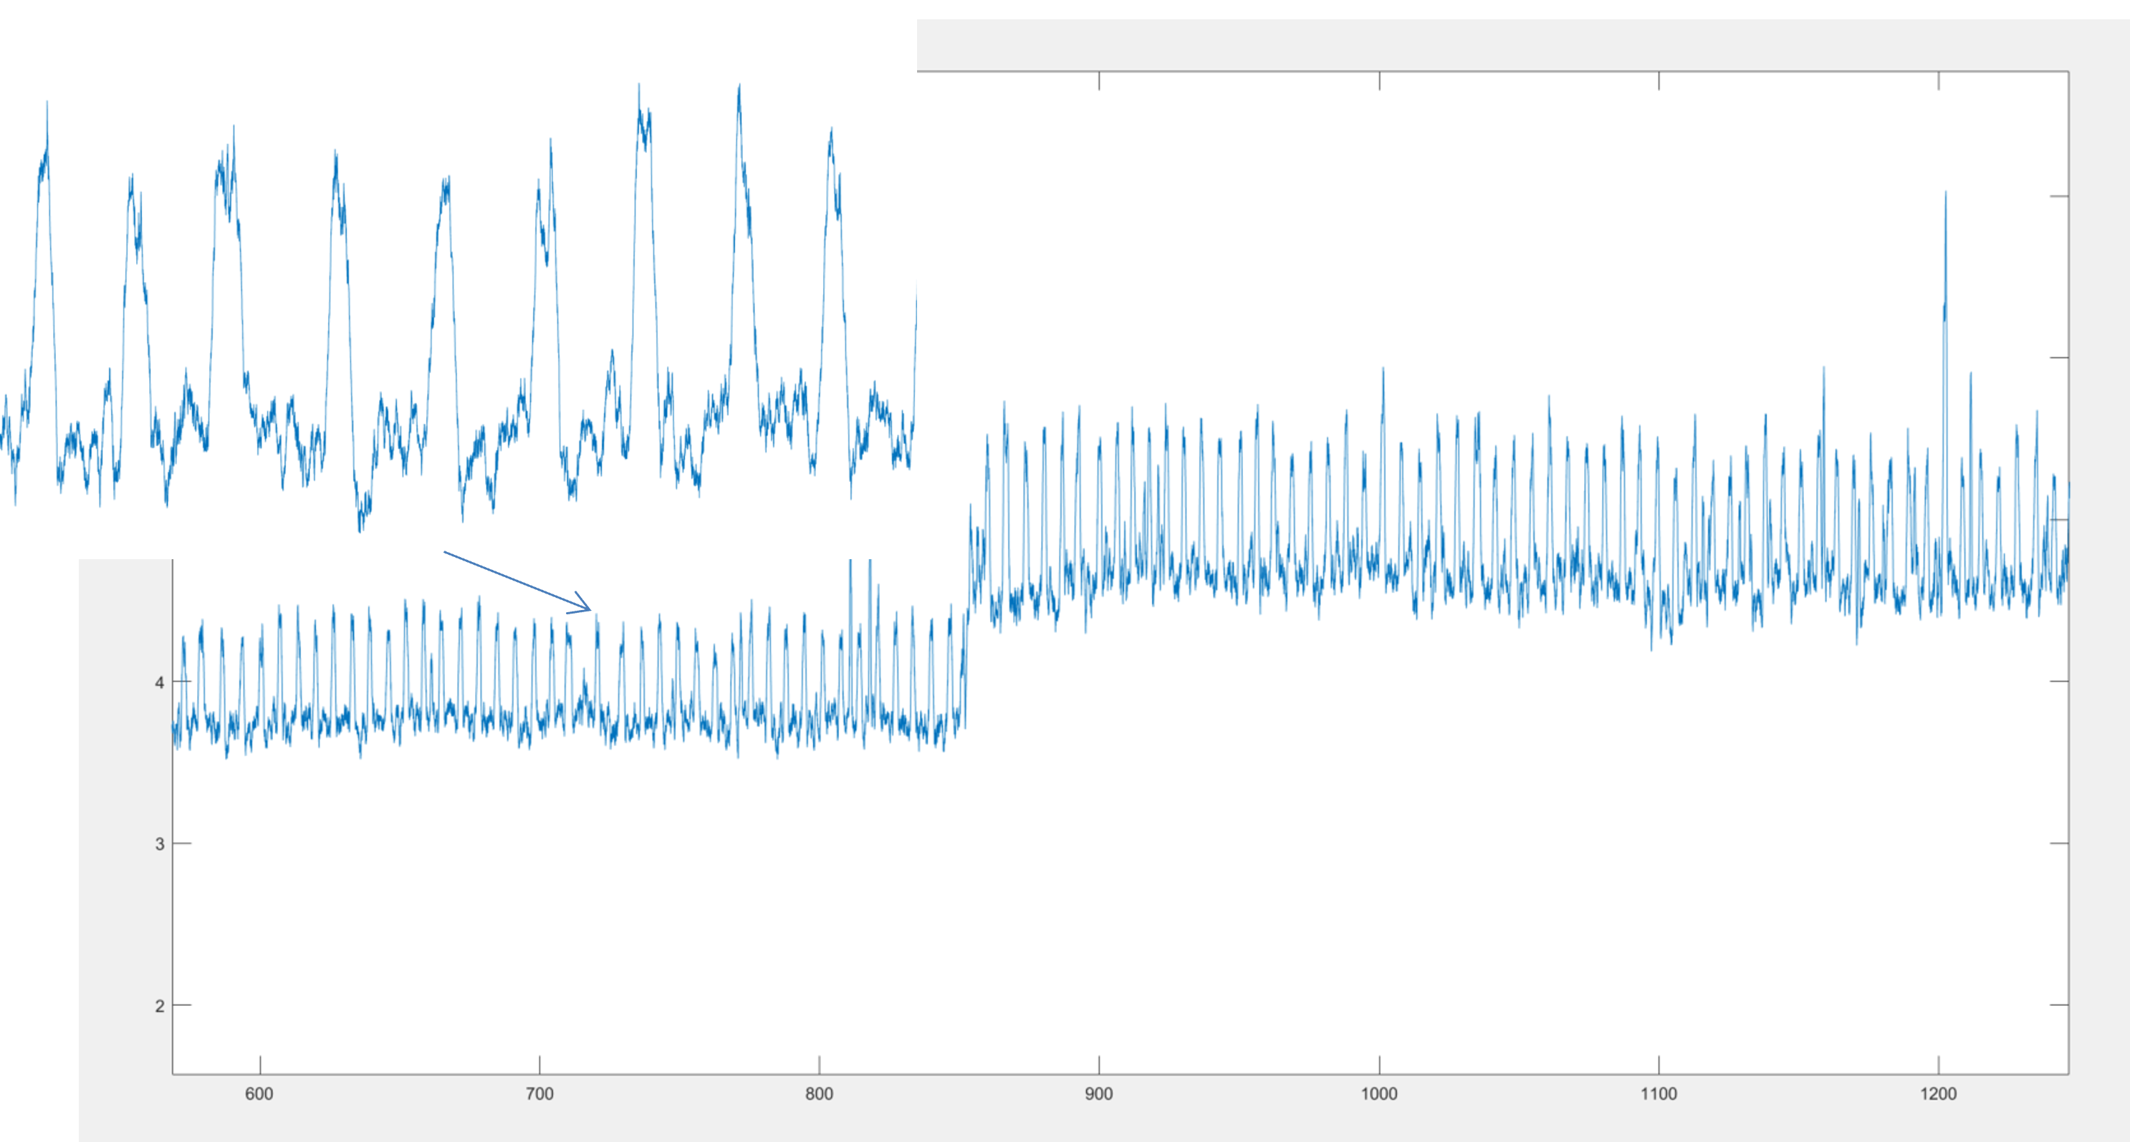
Sample EMG Data “Normal” Labor
Contraction Processing
Time (mins)
Notes:
Over 10 hours

Slide 16
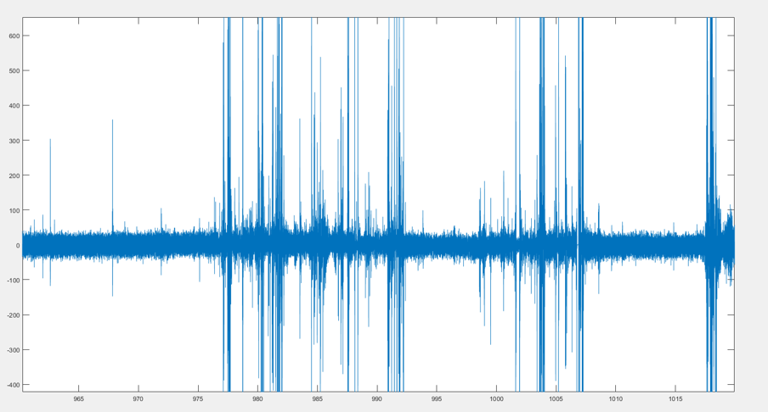
Sample EMG Data with Dystocia
Filtered and Zoomed Out
Time (mins)
Notes:
Over 50 mins

Slide 17
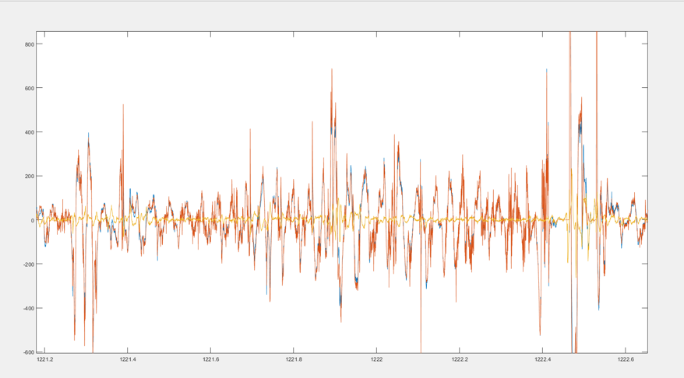
Sample EMG Data with Dystocia
Filtered and Zoomed In
Time (mins)
Notes:
Over 1 minute

Slide 18
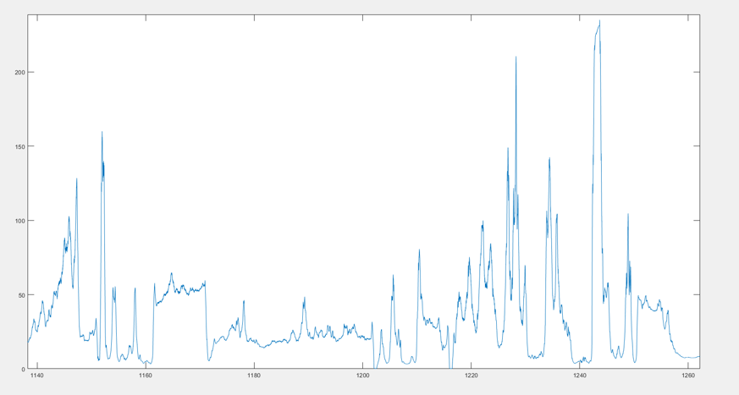
Sample EMG Data with Dystocia
Contraction Processing
Time (mins)
Notes:
Over 2 hours

Slide 19
Individual EMG Data
Notes:
DNU= did not use, only 20 minute segment
Unclear about why LP003 had such a short duration of ctx
Power density spectrum frequency
Ctx duration

Slide 20
Preliminary Summary EMG Results

Slide 21
Next Steps
Finalize analysis
Lessons Learned
Labor Dystocia Study
Symptom analysis
Mixed Methods
Model Biobehavioral Variables
Analyze ACE Scores
EMG
MyCap
Symptoms
Prospective
EMG, AFL, Cytokines
Experience

Slide 22
Thank You
Katy Kissler
Katherine.kissler@cuanschutz.edu

